Slide 1
Chapter 5
Acid-Base Equilibrium
Table of Contents
Introduction
Acid-Base Theories
Ionization of Water
The pH Scale
Strength of Acids and Bases
Neutralization
Titration
Hydrolysis
Buffer Solutions

Slide 2
Chapter 5
Acid-Base Equilibrium
Warm up
Think about substances that you encounter in a typical day and make two lists.
  One list should contain substances that might be acids.
  The other should contain substances that might be bases.

Slide 3

Chapter 5
Acid-Base Equilibrium

Slide 4
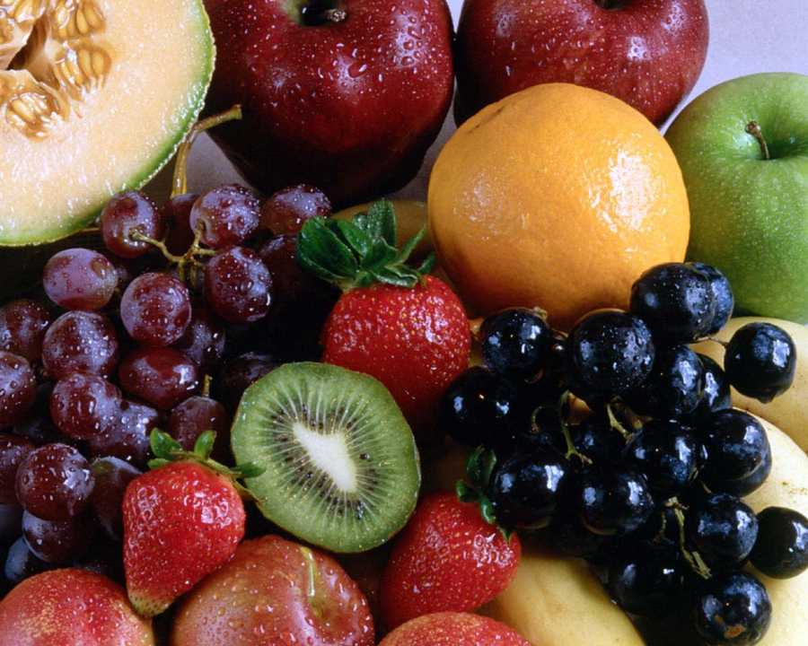
Chapter 5
Introduction
The term acid is “acere”,
in Latin language, meaning sour.
In 17th century the English
chemist Robert Boyle grouped the
substances as either acids or bases.
Acids and bases are found in many fruits, vegetables and some household products, like vinegar, apple, oranges, lemons, grapes, soaps, etc.
To explain the behavior of acids and bases there are many acid-base theories.

Slide 5
Chapter 5
1. Acid-Base Theories
1. The Arrhenius Acid-Base Theory
In 1884, Swedish chemist Svante Arrhenius defined acids as
compounds that produce H⁺ ions in aqueous solutions, and
bases compounds that produce OH⁻ ions in aqueous solutions.
This theory was insufficient to explain the acidic or basic
properties of some substances such as SO₃ or NH₃.

Slide 6
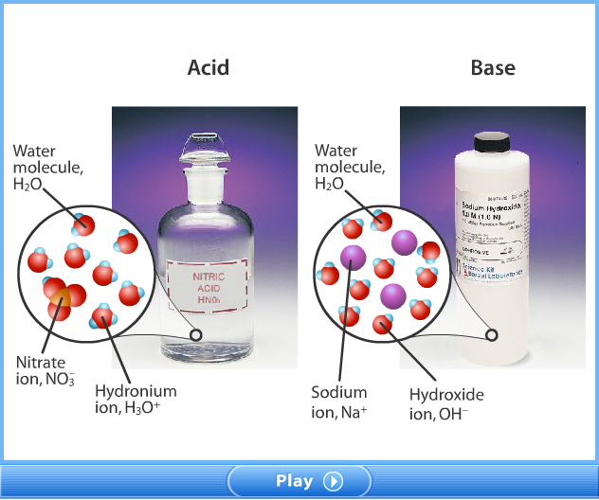
Chapter 5
1. Acid-Base Theories
1. The Arrhenius Acid-Base Theory

Slide 7
Chapter 5
1. Acid-Base Theories
2. Bronsted – Lowry Acid-Base Theory
It was proposed independently by Johannes Nicolaus Brønsted and Thomas Martin Lowry in 1923.
An acid is defined as any chemical species (molecule or ion) that is able to lose, or "donate" a hydrogen ion (proton), and a base is a species with the ability to gain or "accept" a hydrogen ion (proton).

Slide 8
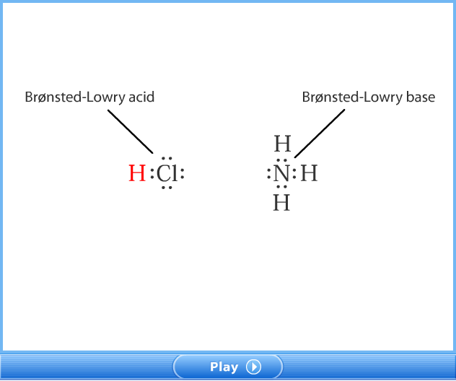
Chapter 5
1. Acid-Base Theories
2. Bronsted – Lowry Acid-Base Theory

Slide 9
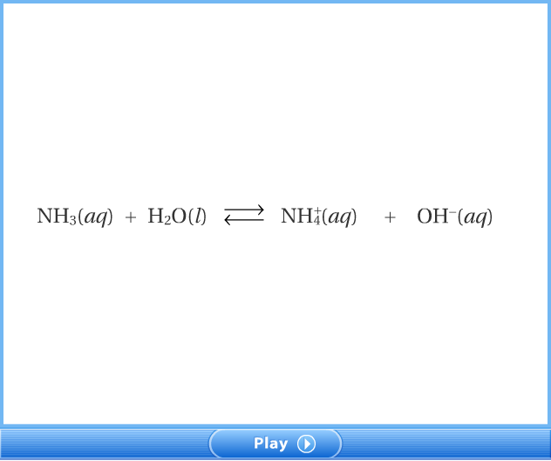
Chapter 5
1. Acid-Base Theories
2. Bronsted – Lowry Acid-Base Theory

Slide 10
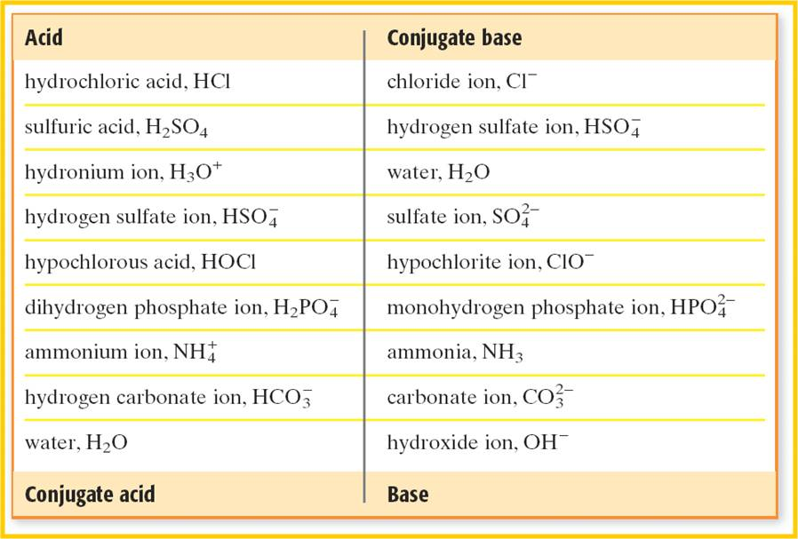
Chapter 5
1. Acid-Base Theories
2. Bronsted – Lowry Acid-Base Theory

Slide 11
Chapter 5
1. Acid-Base Theories
2. Bronsted – Lowry Acid-Base Theory
Example 1
Show the conjugate acid-base pairs in the following reaction.
CH₃COOH + H₂O ⇔ CH₃COO⁻ + H₃O⁺
Solution
CH₃COOH and CH₃COO⁻ ,
H₂O and H₃O⁺ are conjugate acid base pairs

Slide 12
Chapter 5
1. Acid-Base Theories
2. Bronsted – Lowry Acid-Base Theory
Example 2
Write the conjugate acids of the following bases.
a. OH⁻ b. CN⁻ c. ClO⁻ d. S⁻²
Solution
a. H₂O b. HCN c. HClO d. HS⁻

Slide 13
Chapter 5
1. Acid-Base Theories
2. Bronsted – Lowry Acid-Base Theory
Example 3
Write the conjugate bases of the following acids.
a. HCO₃⁻ b. H₃O⁺ c. CH₃NH₃⁺ d. HS⁻
Solution
a. CO₃⁻² b. H₂O c. CH₃NH₂ d. S⁻²

Slide 14
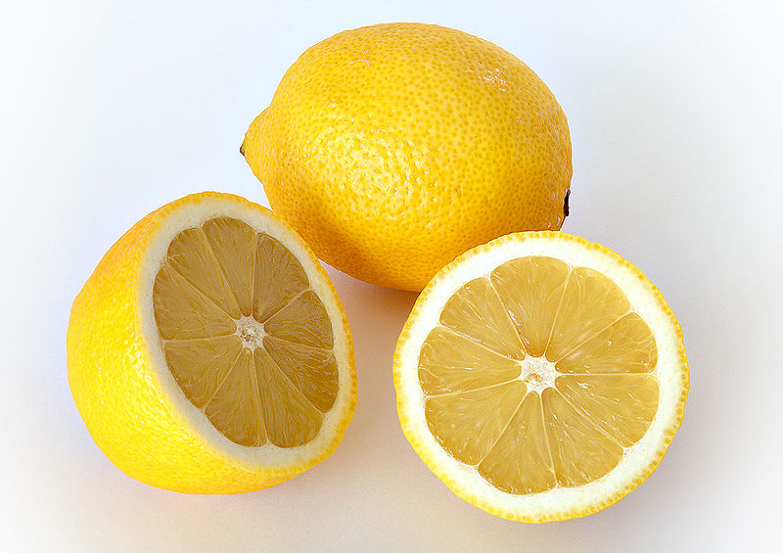
Chapter 5
1. Acid-Base Theories
1. General Properties of Acids
Are generally sour in taste,
Are corrosive substances
Change the color of litmus paper to red,
React with metals to produce a metal salt and hydrogen gas,
React with metal carbonates to produce water, CO₂ and a salt,
React with bases to produce water and a salt, neutralization reaction,
Conduct electricity.

Slide 15
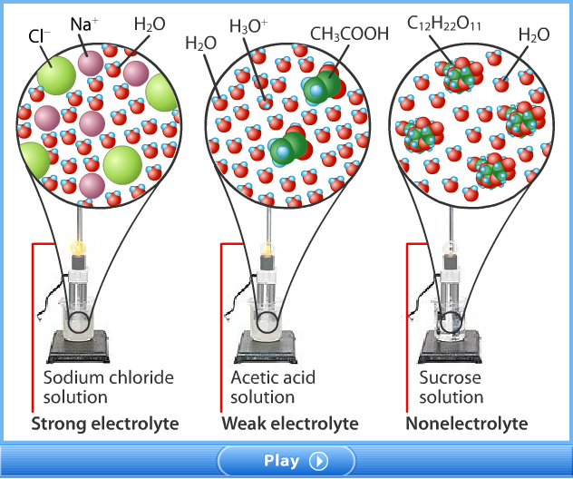
Chapter 5
1. Acid-Base Theories
1. General Properties of Acids

Slide 16
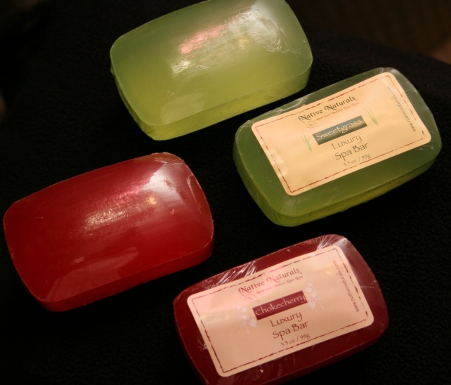
Chapter 5
1. Acid-Base Theories
2. General Properties of Bases
Are generally bitter in taste,
Cause slippery feeling to skin,
Change the color of litmus paper to blue,
Strong bases are corrosive,
React with amphoteric metals to produce a metal salt and hydrogen gas,
React with acids to produce water and a salt, neutralization reaction,
Conduct electricity.

Slide 17

Chapter 5
1. Acid-Base Theories
2. General Properties of Bases

Slide 18

Chapter 5
1. Acid-Base Theories
2. General Properties of Bases

Slide 19

Chapter 5
1. Acid-Base Theories
2. General Properties of Bases

Slide 20
Chapter 5
2. Ionization of Water
Water is an amphoteric substance, acting as a base against acids and as an acid against bases.
H₂O(I) + H₂O(I) ⇔ OH⁻(aq) + H₃O⁺(aq)
Equilibrium constant expression for the ionization of water is
Kw=[H₃O⁺] [OH⁻]
at 25ºC Kw has a value Kw=1x10⁻¹⁴
when water is neutral
Kw=[H₃O⁺] [OH⁻]=1x10⁻¹⁴, then
[H₃O⁺]= [OH⁻]=1x10⁻⁷ M.

Slide 21
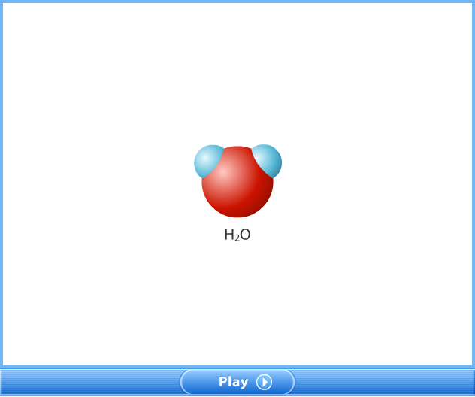
Chapter 5
2. Ionization of Water

Slide 22
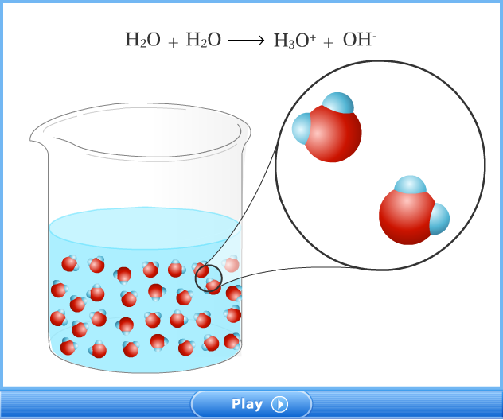
Chapter 5
2. Ionization of Water

Slide 23
Chapter 5
3. The pH Scale
pH is a measure of the acidity or basicity of a solution.
It is defined as the cologarithm of the concentration of dissolved hydrogen ions (H⁺).
It varies between 0 to 14.
Indicators are used to determine the acidity level of solutions.
Similarly for [OH⁻] ion pOH can be expressed as;

Slide 24
Chapter 5
3. The pH Scale
For pure water at 25ºC,
[H⁺]= 1x10⁻⁷ M and [OH⁻]= 1x10⁻⁷ M.
pH = - log(1x10⁻⁷) = 7 and pOH = - log(1x10⁻⁷) = 7
The pH value of a solution gives an idea about the condition of a solution as follows;
if pH<7.0 solution is acidic,
if pH= 7.0 solution is neutral,
if pH >7.0 solution is basic.

Slide 25
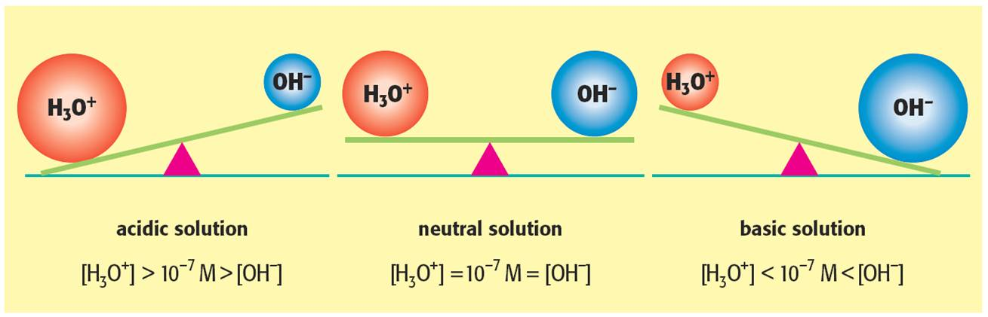
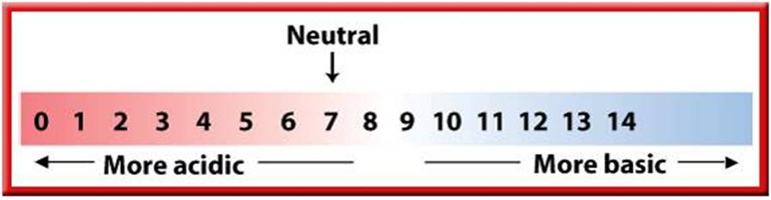
Chapter 5
3. The pH Scale

Slide 26
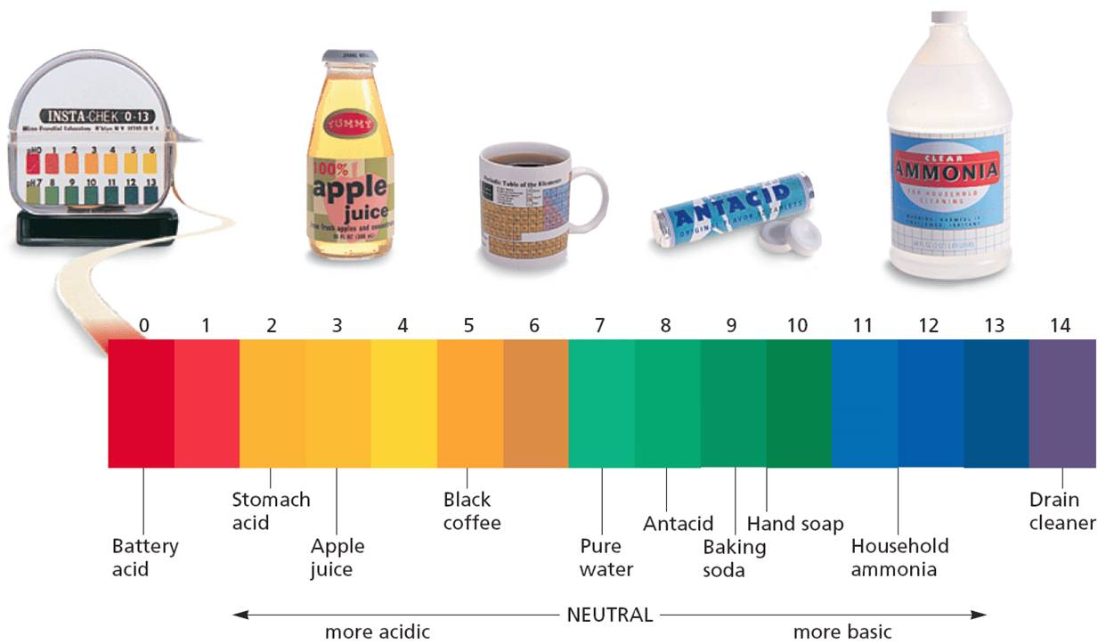
Chapter 5
3. The pH Scale

Slide 27
Chapter 5
3. The pH Scale
Example 4
Calculate the pH and pOH of the solutions given below.
(log5 =0.7, log8 = 0.9)
A solution with a [H⁺] of 1x10⁻³ M.
A solution with a [OH⁻] of 1x10⁻³ M.
A solution with a [H⁺] of 5x10⁻⁷ M.
A solution with a [OH⁻] of 8x10⁻¹¹ M.

Slide 28
Chapter 5
3. The pH Scale
Example 5
A sample of vinegar has a pH of 3. Calculate the pOH, [H⁺],
and [OH⁻].
Example 6
Lemon juice has a hydrogen ion concentration of 4x10⁻³M.
Calculate the pH, and pOH, and [OH⁻]. (log 4 = 0.6)

Slide 29
Chapter 5
3. The pH Scale
Example 7
Fill the following table for each of the solution.
Solution | [H⁺] | [OH⁻] | pH | pOH
0.05 M NaOH
0.05 M H₂SO₄
0.05 M Ca(OH)₂

Slide 30
Chapter 5
3. The pH Scale
Solution
Solution | [H⁺] | [OH⁻] | pH | pOH
0.05 M NaOH | 2x10⁻¹³ | 5x10⁻² | 12.7 | 1.3
0.05 M H₂SO₄ | 0.1 | 10⁻¹³ | 1 | 13
0.05 M Ca(OH)₂ | 10⁻¹³ | 0.1 | 13 | 1

Slide 31
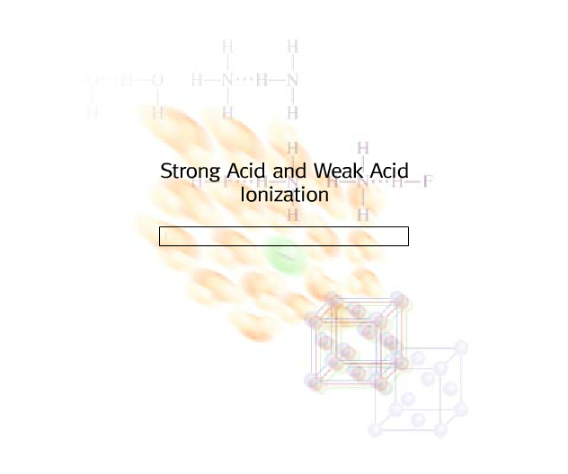
Chapter 5
4. Strength of Acids and Bases

Slide 32
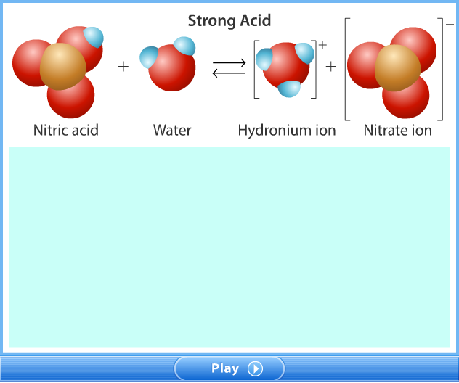
Chapter 5
4. Strength of Acids and Bases

Slide 33
Chapter 5
4. Strength of Acids and Bases
Acid Strength
Acids are classified as weak or strong according to their
degree of dissociation in water.
Weak acids ionizes reversibly to form H₃O⁺ ion in small
extent. Usually fewer than 1 percent.
Its solution does not conduct electricity well.
HA(aq) + H₂O(l) ⇔ H₃O⁺(aq) + A⁻(aq)

Slide 34
Chapter 5
4. Strength of Acids and Bases
Acid Strength
Ka is acid dissociation constant referring the measure of an acid’s strength.
    If Ka<1.10⁻³, acid is generally said to be weak.
    If Ka=1 to 1.10⁻³, acid is accepted as moderate.
    If Ka>1 , acid is strong.

Slide 35
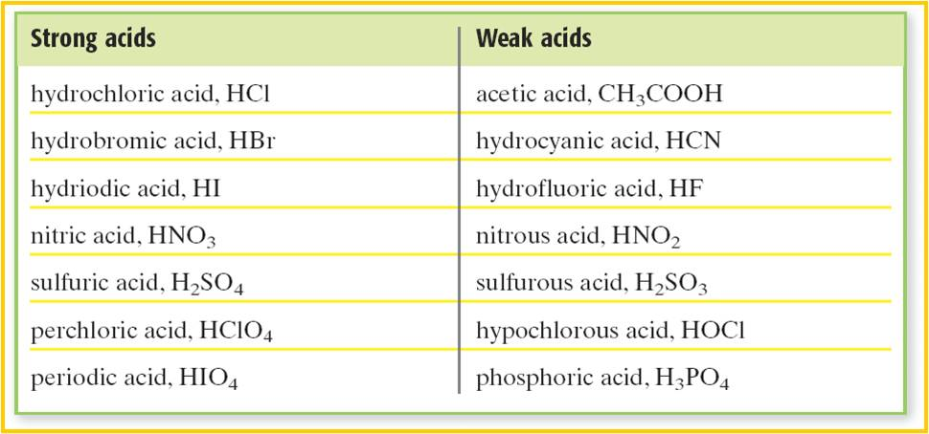
Chapter 5
4. Strength of Acids and Bases
Acid Strength

Slide 36
Chapter 5
4. Strength of Acids and Bases
Base Strength
Strength of bases are also similar to acids.
B(aq) + H₂O(l) ⇔ BH⁺(aq) + OH⁻(aq)
Kb is base dissociation constant referring the measure of a base’s strength.

Slide 37
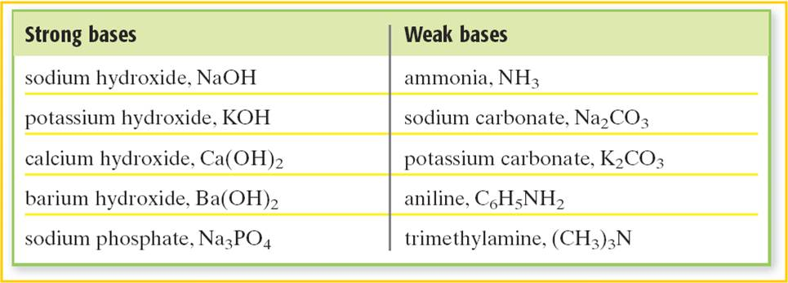
Chapter 5
4. Strength of Acids and Bases
Base Strength

Slide 38
Chapter 5
4. Strength of Acids and Bases
Example 8
Write the K_{a} or K_{b} expressions of the following weak acids
and bases.
HF
NH₃
H₂CO₃
H₃PO₄

Slide 39
Chapter 5
4. Strength of Acids and Bases
Example 9
A 9.4 g sample of the acid HA, is dissolved in 500 mL of
solution, has a [H⁺] = 1.10⁻⁴ M. If the molecular weight of the
acid is 188 g/mol, calculate;
molarity of the acid solution,
the [A⁻],
the value of K_{a} for HA.

Slide 40
Chapter 5
4. Strength of Acids and Bases
Solution
b. HA(aq) + H₂O(l) ⇔ H₃O⁺(aq) + A⁻(aq)
Initial: 0.1 M - -
Change: -1.10⁻⁴ M +1.10⁻⁴ M +1.10⁻⁴ M
At Equilib: 0.1- 1.10⁻⁴ M 1.10⁻⁴ M 1. 10⁻⁴ M
neglected

Slide 41
Chapter 5
4. Strength of Acids and Bases
Example 10
A solution of nitrous acid, HNO₂, contains 1.41 g of HNO₂ in
10 L water and has a pH of 3. What is the dissociation
constant of the acid? And percent dissociation of the acid.
(H:1, N:14, O:16)
Solution

Slide 42
Chapter 5
4. Strength of Acids and Bases
Solution
HNO₂(aq) + H₂O(l) ⇔ H₃O⁺(aq) + NO₂⁻(aq)
Initial: 0.003 M - -
Change: -0.001 M +0.001 M +0.001 M
At Equilib: 0.002 M 0.001 M 0.001M

Slide 43
Chapter 5
4. Strength of Acids and Bases
Example 11
What molarity of NH₃ solution provides a pH value of 11?
(K_{b} = 2x10⁻⁵)
Solution

Slide 44
Chapter 5
4. Strength of Acids and Bases
Solution
NH₃(aq) + H₂O(l) ⇔ OH⁻(aq) + NH₄⁺(aq)
Initial: x M - -
Change: -0.001 M +0.001 M +0.001 M
At Equilib: x-0.001 M 0.001 M 0.001M

Slide 45
Chapter 5
4. Strength of Acids and Bases
Relationship Between K_{a} and K_{b}
K_{a} and K_{b} of a conjugate acid-base pair has the following relationship;
Example 12
What is the K_{b} value of F⁻ ion if it has a K_{a} value of 7.2x10⁻⁴?
Solution
F⁻ ion is conjugate base of HF. Then, K_{w}=1.10⁻¹⁴=K_{b}x 7.2x10⁻⁴
K_{b}= 1.39x10⁻¹¹

Slide 46
Chapter 5
5. Neutralization
The reaction between an acid and a base to form salt and water is called neutralization. Indeed it is the reaction between H⁺ ion and OH⁻ ion to form water.
HCl(aq) + NaOH(aq) → NaCl(aq) + H₂O(l)
H⁺(aq) + OH⁻(aq) → H₂O(l)
The nature of the particular acid and base involved in a reaction determines the acidity or basicity of the resulting solution.

Slide 47
Chapter 5
5. Neutralization
strong acid + strong base → neutral solution
strong acid + weak base → acidic solution
weak acid + strong base → basic solution
weak acid + weak base → acidic or basic solution depends upon K_{a} and K_{b} values.
Example 13
What will be the pH of the resulting solution which is prepared
by mixing 60 mL and 0.4 M NaOH solution and 40 mL of 0.3 M
HBr solution?

Slide 48
Chapter 5
5. Neutralization
Solution
HBr(aq) + NaOH(aq) → NaBr(aq) + H₂O(l)
0.3 M 0.4 M
40mL 60mL
After neutralization 0.024 – 0.012 = 0.012 mol NaOH remains
unreacted which makes resulting solution basic and volume
of the solution is 60 + 40 = 100 mL.

Slide 49
Chapter 5
5. Neutralization
Example 14
A 6.4 g impure sample of NaOH is completely neutralized by
50 mL of 0.4 M HCl. Calculate the percentage purity by mass
of NaOH in the sample?
Solution
Because the complete neutralization had occurred mole
numbers of H⁺ and OH⁻ ions are equal. Therefore moles of
NaOH and HCl are equal.

Slide 50
Chapter 5
5. Neutralization
Example 15
A 0.5 g impure sample of a diprotic acid, which is 90% by
mass is completely neutralized by 50 mL of 0.2 M KOH
solution. Find the molecular weight of the acid?
Solution
Because the complete neutralization had occurred mole
numbers of H⁺ and OH⁻ ions are equal.

Slide 51
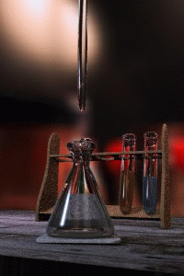
Chapter 5
6. Titration
Titration is a process for analyzing the amount of acid or base in a solution.
In titration the solution whose volume and
concentration are known is called titrant or
standard solution.
The neutralization point is known as an
equivalence point or end-point. It is monitored
by using an acid or a base indicator.

Slide 52
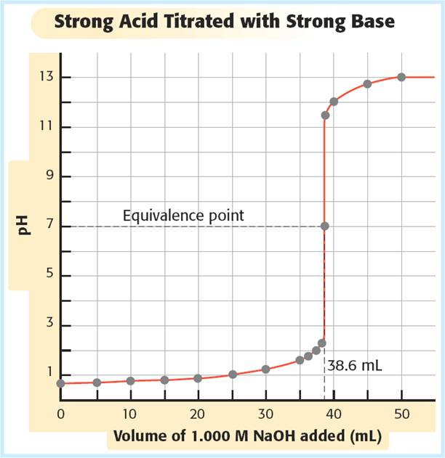
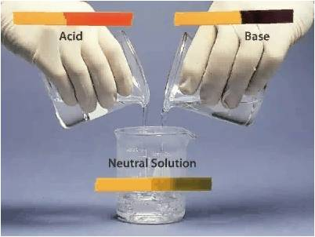
Chapter 5
6. Titration

Slide 53
Chapter 5
6. Titration

Slide 54
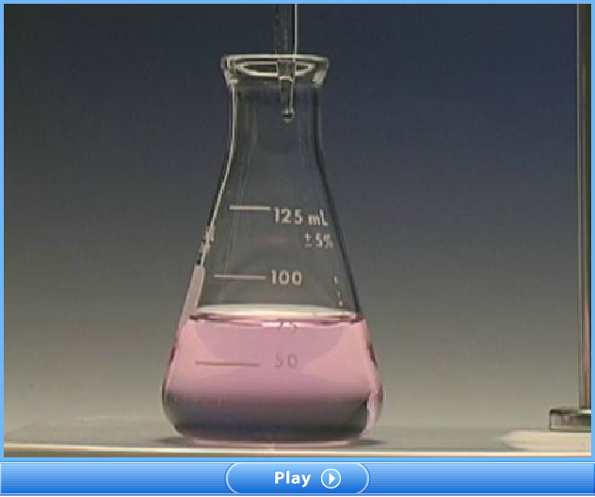
Chapter 5
6. Titration

Slide 55
Chapter 5
6. Titration

Slide 56

Chapter 5
6. Titration

Slide 57
Chapter 5
6. Titration
Example 16
A 0.1 M of 50 mL HCl solution is titrated with 0.1 M NaOH
solution. Calculate the pH of the final solutions in each of the
following cases and draw a curve showing pH versus volume
of NaOH added.
In the original acid solution.
After 10 mL of NaOH solution has been added.
After 49 mL of NaOH solution has been added.
After 50 mL of NaOH solution has been added.
After 60 mL of NaOH solution has been added.

Slide 58
Chapter 5
6. Titration
Solution
a. [H⁺] = 0.1M, then pH= -log(0.1) = 1

Slide 59
Chapter 5
6. Titration
Solution

Slide 60
Chapter 5
6. Titration
Solution

Slide 61
Chapter 5
6. Titration
Solution

Slide 62
Chapter 5
7. Hydrolysis
Hydrolysis is the general term of the chemical reactions of anions with water.
Salts of weak acids and bases hydrolyze in aqueous solutions.
For example NaF is a salt formed from strong base and weak acid.
F⁻ + H₂O ⇔ HF + OH⁻
K_{b} is dissociation constant of the weak base
For the salts produced from weak acid and weak bases;
if K_{a}>K_{b}, then salt is acidic.
if K_{a}<K_{b}, then salt is basic.

Slide 63
Chapter 5
7. Hydrolysis
Example 17
What is the pH of 0.1 M NaNO₂ solution?
(K_{a} for HNO₂=5.10⁻⁴)
Solution
In the salt NO₂⁻ ion is weak acid anion, thus it hydrolyzes.
NO₂⁻ + H₂O ⇔ HNO₂ + OH⁻
Initial 0.1 M - -
Change -x +x +x
At equil 0.1-x M x M x M
neglected

Slide 64
Chapter 5
7. Hydrolysis
Example 18
Calculate the mass of sodium acetate, CH₃COONa, that
must be dissolved in water to make a 0.5 L solution which
has a pH value of 9? K_{a} for CH₃COOH = 1.8x10⁻⁵ and
CH₃COONa=82 g/mol.
Solution
In the salt CH₃COO⁻ ion is weak acid anion, thus it hydrolyzes.
CH₃COO⁻ + H₂O ⇔ CH₃COOH + OH⁻
Initial a M - -
Change -x +x +x
At equil a-x M x M x M
neglected

Slide 65
Chapter 5
7. Hydrolysis
Solution

Slide 66
Chapter 5
8. Buffer Solutions
A buffer solution is an aqueous solution consisting of a mixture of a weak acid and its conjugate base or a weak base and its conjugate acid.
It has the property that the pH of the solution changes very little when a small amount of acid or base is added to it.
Buffer solutions are used as a means of keeping pH at a nearly constant value in a wide variety of chemical applications. Such as pH of blood, to maintain pH stability carbonic acid-bicarbonate buffer system is used.

Slide 67
Chapter 5
8. Buffer Solutions

Slide 68
Chapter 5
8. Buffer Solutions
In a simple buffer solution there is an equilibrium between a weak acid, HA, and its conjugate base, A⁻.
HA + H₂O⇔ H₃O⁺ + A⁻
The acid dissociation constant for a weak acid, HA, is defined as
Simple manipulation with logarithms gives the Henderson-Hasselbalch equation, which describes pH in terms of pKa.

Slide 69
Chapter 5
8. Buffer Solutions
Example 19
Calculate the pH of a buffer solution prepared by mixing 500
mL of 0.1 M NaF and 500 mL of 0.02 M HF?
(K_{a} for HF =6.7x10⁻⁴)
Solution

Slide 70
Chapter 5
8. Buffer Solutions
Example 19
0.15 mol of sodium acetate(CH₃COONa) and 0.1 mol acetic
acid (CH₃COOH) are added to enough water to make 1 L
buffer solution. If K_{a} for CH₃COOH = 1.8x10⁻⁵)
What is the pH of the solution?
What will be the pH of the solution if 0.01 mol HNO₃ is added?
What will be the pH of the solution if 0.01 mol NaOH is added?

Slide 71
Chapter 5
8. Buffer Solutions
Solution
a.
CH₃COOH + H₂O ⇔ CH₃COO⁻ + H₃O⁺
Initial 0.1 M 0.15 M -
Change -x +x +x
At eq. 0.1-x M 0.15 + x M x M
neglected
neglected

Slide 72
Chapter 5
8. Buffer Solutions
Solution
b. From 0.01 mol HNO₃ , 0.01 mol H₃O⁺ ion is produced and it
combines with CH₃COO⁻ ion to produce 0.01 mol CH₃COOH.
CH₃COOH + H₂O ⇔ CH₃COO⁻ + H₃O⁺
In buffer 0.1 M 0.15 M 1.2x10⁻⁵ M
Addition +0.01M
Changes +0.01 M -0.01 M -0.01 M
In final buffer 0.11 M 0.14 M x M

Slide 73
Chapter 5
8. Buffer Solutions
Solution
c. From 0.01 mol NaOH , 0.01 mol OH⁻ ion is produced and it
combines with CH₃COOH to produce 0.01 mol CH₃COO⁻.
CH₃COOH + H₂O ⇔ CH₃COO⁻ + H₃O⁺
In buffer 0.1 M 0.15 M 1.2x10⁻⁵ M
Addition - +0.01 -
Changes -0.01 M +0.01 M x M
In final buffer 0.09 M 0.16 M x M

Slide 74
End of the chapter 5

