Slide 1
Chapter 5
Carbohydrates
Table of Contents
Introduction
Structure of Carbohydrates
Common Carbohydrates
    Glucose
    Fructose
    Sucrose
    Starch
    Cellulose

Slide 2
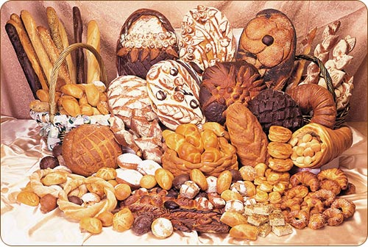
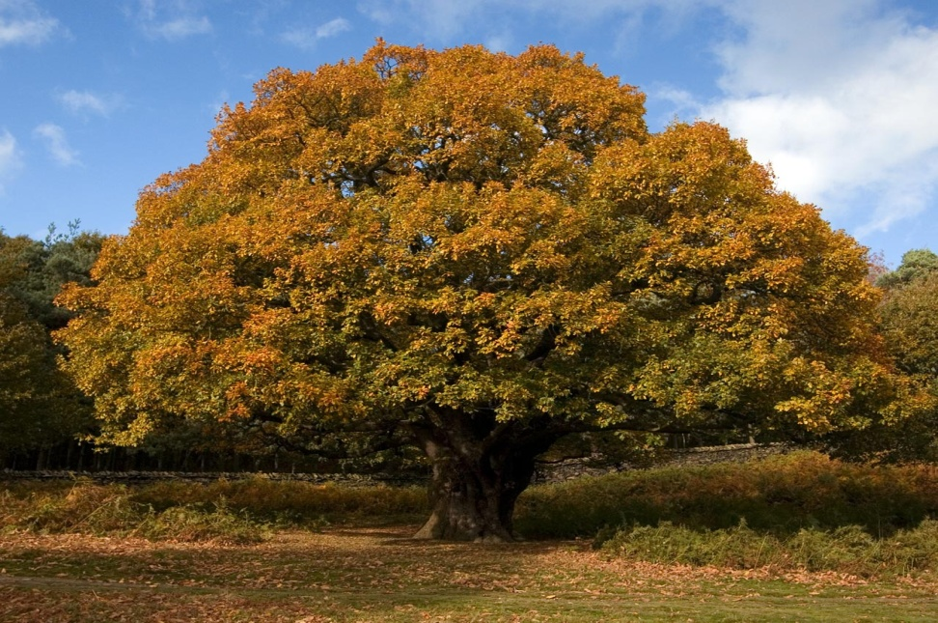
Chapter 5
Carbohydrates
Warm Up
What are the energy sources
of living beings?
How these sources are
produced in nature?
What is photosynthesis?

Slide 3
Chapter 5
Introduction
They are most common and abundant organic compounds found in doors, furniture, foods, clothes, paper…etc.
Cellulose, starch, glucose, fructose, lactose, and sucrose are the most common carbohydrates.
They are produced in green plants with photosynthesis.
Photosynthesis ↔ Respiration

Slide 4

Chapter 5
1. Structure of Carbohydrates
CH₂O is the empirical formula of carbohydrates.
C_{n}(H₂O)_{n} is general formula.
The name saccharide is from sweet taste.
They contain alcohol, aldehyde and/or ketone
Monosaccharides do not undergo hydrolysis, and polysaccharides hydrolyze to form monosaccharides

Slide 5

Chapter 5
1. Structure of Carbohydrates

Slide 6

Chapter 5
Common Carbohydrates
Common monosaccharides are glucose and fructose, both contain six carbon atoms in their molecules also called hexoses.
1. Glucose
Colorless, crystalline sweet substance, well soluble in water, because of the OH⁻ groups in the molecule, and forms hydrogen bonds.
In the structure there are both aldehyde and hydroxyl groups, therefore when oxidized gluconic acid is formed.

Slide 7

Chapter 5
Common Carbohydrates
1. Glucose
The calcium salt of gluconic acid is widely used in medicine and is called calcium gluconate (antiallergic, anti-inflammatory).
Tollen’s reagent oxidizes glucose to gluconic acid and silver mirror is formed.

Slide 8


Chapter 5
Common Carbohydrates
1. Glucose
When glucose is reduced hexahydroxylic alcohol is formed, called sorbitol, is used as raw material to produce vitamin C.

Slide 9
Chapter 5
Common Carbohydrates
1. Glucose

Slide 10


Chapter 5
Common Carbohydrates
1. Glucose
Fermentation is another important chemical property.
2. Fructose
Produced by photosynthesis, found in fruits, grape and honey, crystalline sweet substance, and well soluble in water, 1.5 times sweeter than sugar and 3 times sweeter than glucose.
It is easily digested by body.
Has molecular formula of C₆H₁₂O₆, isomer of glucose.

Slide 11
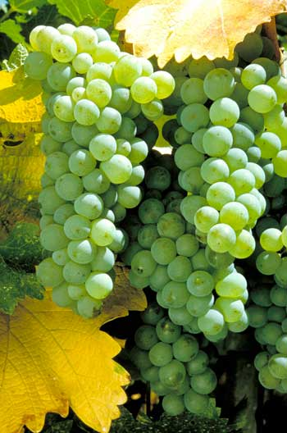
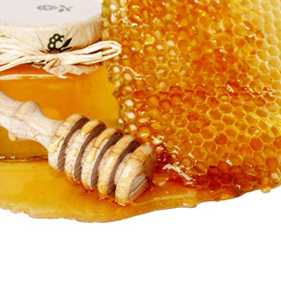
Chapter 5
3. Classification of Carbohydrates
1. Monosaccharides
Number of carbon atoms in the structure
of a monosaccharide varies 2-9.
They cannot be hydrolyzed.
Glucose is a well-known monosaccharide. It is the energy source of living organisms, stored in liver and muscles, found in grape and honey.
They are white crystalline, soluble in water,
and sweet compounds.
They have optical activity.

Slide 12
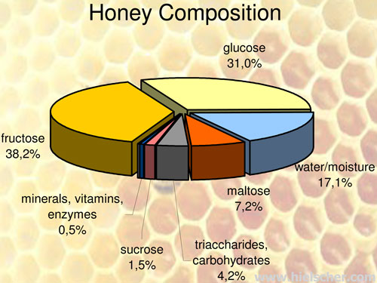
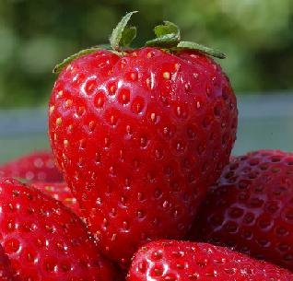
Chapter 5
3. Classification of Carbohydrates
1. Monosaccharides
When monosaccharide is dissolved in water it forms cyclic monosaccharide.

Slide 13
Chapter 5
3. Classification of Carbohydrates
1. Monosaccharides
Tollens’ and Fehling’s reagents oxidize monosaccharides.

Slide 14
Chapter 5
3. Classification of Carbohydrates
1. Monosaccharides
Ketoses also reduce both Fehling’s and Tollens’ reagents.

Slide 15
Chapter 5
3. Classification of Carbohydrates
1. Monosaccharides
Aldehyde and ketone groups can be reduced by strong reducing agents.

Slide 16
Chapter 5
3. Classification of Carbohydrates
1. Monosaccharides

Slide 17
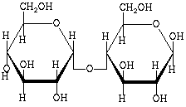
Chapter 5
3. Classification of Carbohydrates
2. Disaccharides
Condensation compounds derived by elimination of a water molecule from two monosaccharide molecules are called disaccharides.
C₁₂H₂₂O₁₁ is general formula.
White crystalline and sweet.
Rotate the plane-polarized light to right.
Hydrolyze to form monosaccharides.
Sucrose(table sugar, cane sugar or beet sugar), maltose (barley sugar), lactose, and cellobiose are natural disaccharides.

Slide 18
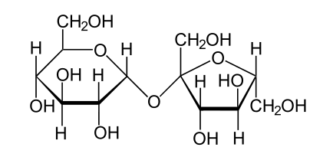
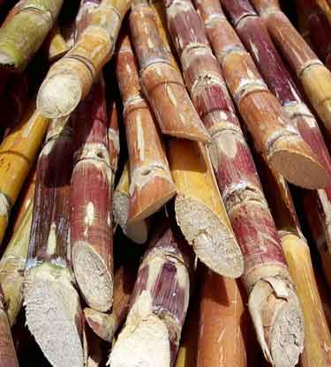
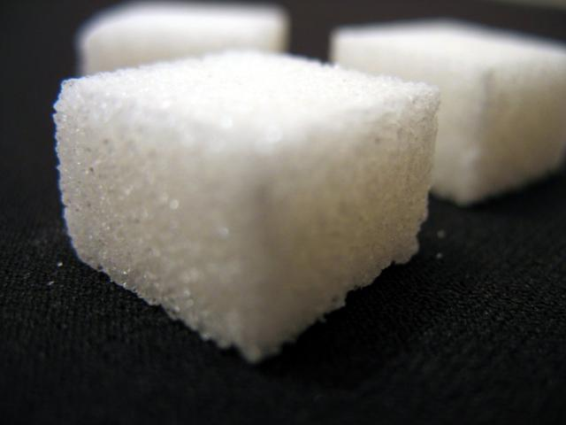
Chapter 5
3. Classification of Carbohydrates
2. Disaccharides
Saccharose (Sucrose)
It is prepared from sugar cane and beat, dissolves in water well and does not react with oxidizing agents.

Slide 19
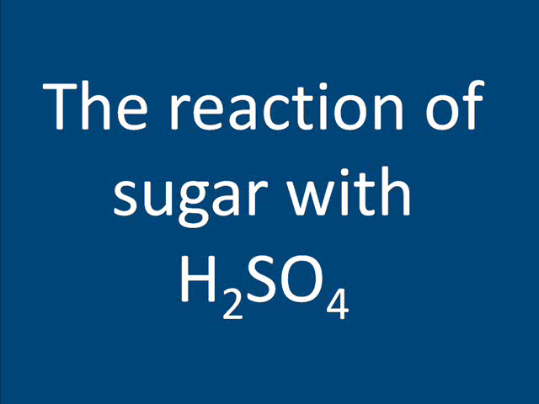
Chapter 5
3. Classification of Carbohydrates
2. Disaccharides, Saccharose (Sucrose)

Slide 20
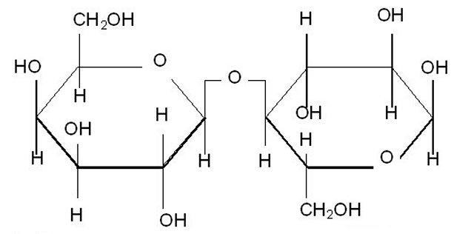
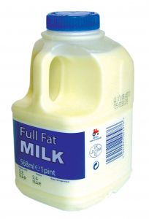
Chapter 5
3. Classification of Carbohydrates
2. Disaccharides
Lactose
It is found in human and cow's milk, when hydrolyzed glucose and galactose is obtained.

Slide 21
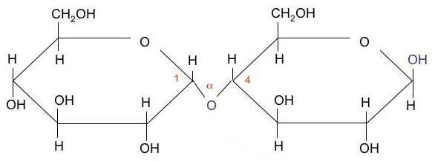
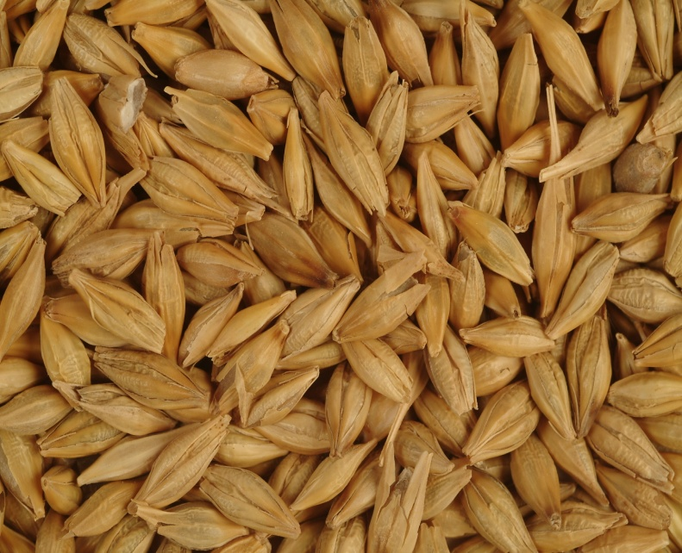
Chapter 5
3. Classification of Carbohydrates
2. Disaccharides
Maltose
It is obtained partial
hydrolsis of starch, it
reduces Fehling's and Benedict's reagents, rotates plane
polarized ligth to left, can be obtained
from barley grain.

Slide 22
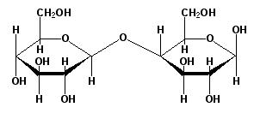
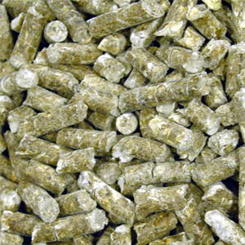
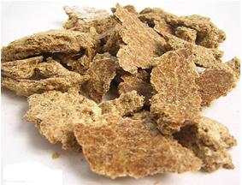
Chapter 5
3. Classification of Carbohydrates
2. Disaccharides
Cellobiose
It is obtained from partial hydrolysis
of cellulose, used for animal fodder.

Slide 23
Chapter 5
3. Classification of Carbohydrates
3. Polysaccharides
They are carbohydrates with a very high molecular weight.
They have a general formula of (C₆H₁₀O₅)_{n}
They do not have sweet taste and are insoluble in water.
Most of them give a single monosaccharide on complete hydrolysis.
Starch, glycogen, dextrin, cellulose are common polysaccharides.

Slide 24
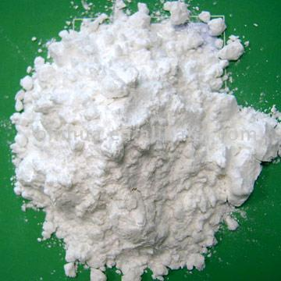
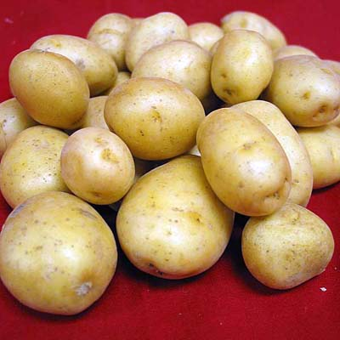
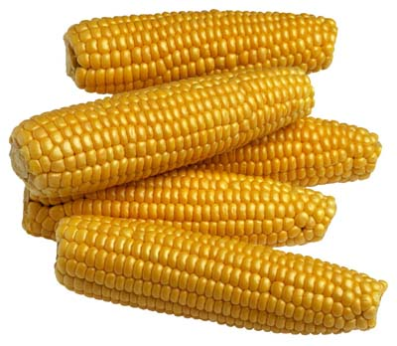
Chapter 5
3. Classification of Carbohydrates
3. Polysaccharides, Starch
It is the most important polysaccharide.
It is energy-storing carbohydrates of plants.
Starch is made up of glucose units.
It can be prepared from cereals, potatoes, corn and rice.
A characteristic reaction of starch with iodine gives blue color

Slide 25
Chapter 5
3. Classification of Carbohydrates
3. Polysaccharides, Glycogen
It is the storage form of carbohydrate in the animal body and often called animal starch.
It is found in liver and muscle tissue.
Soluble in water and pink color upon reaction with iodine.
Dextrin
It is found germinating grains, but usually obtained by the
partial hydrolysis of starch.
Soluble in water, and used in adhesives and soft drinks.

Slide 26
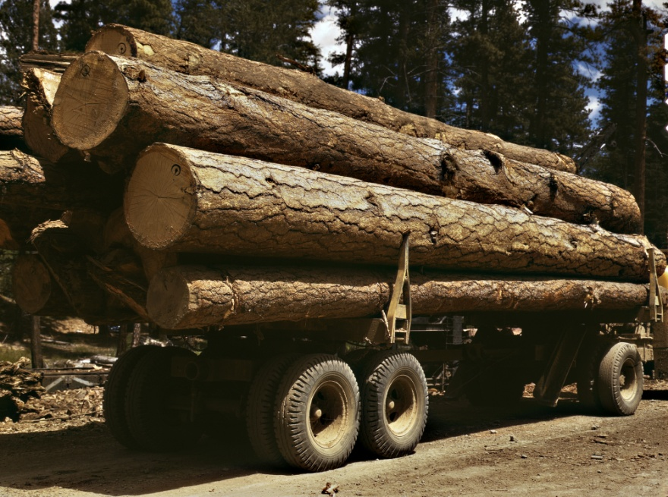

Chapter 5
3. Classification of Carbohydrates
3. Polysaccharides, Cellulose
It is the most abundant organic compound in the world.
Wood and cotton are chiefly cellulose.
It is composed of a straight chain polymer of glucose molecules.

Slide 27
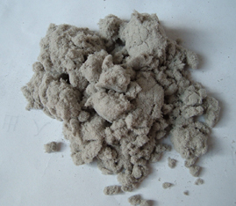

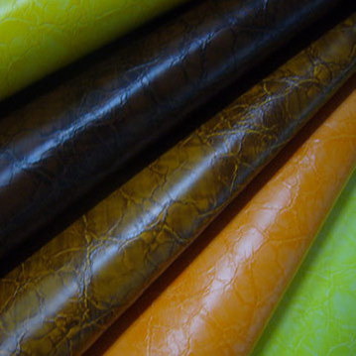
Chapter 5
3. Classification of Carbohydrates
3. Polysaccharides, Cellulose
When cotton is treated with HNO₃ gives nitro cellulose, commercially important ester, used in explosives.
Proxylin, another nitrocellulose, can be made into celluloid, picture film, artificial leather.

Slide 28
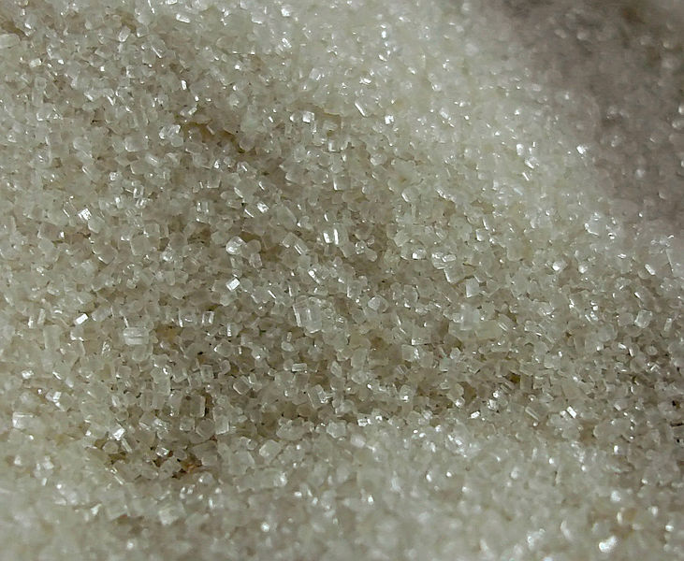
Chapter 5
Sugar
Sugar is a general name containing carbohydrate (C, H and O elements), sweet-flavored substance, most of which is used as food. Simple sugars are called
monosaccharides and include glucose (also known as dextrose), fructose and galactose.
The table or granulated sugar most customarily used as food is sucrose, a disaccharide (in the body, sucrose hydrolyses into fructose and glucose).

Slide 29
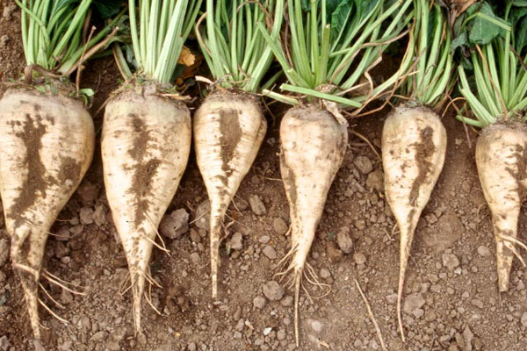
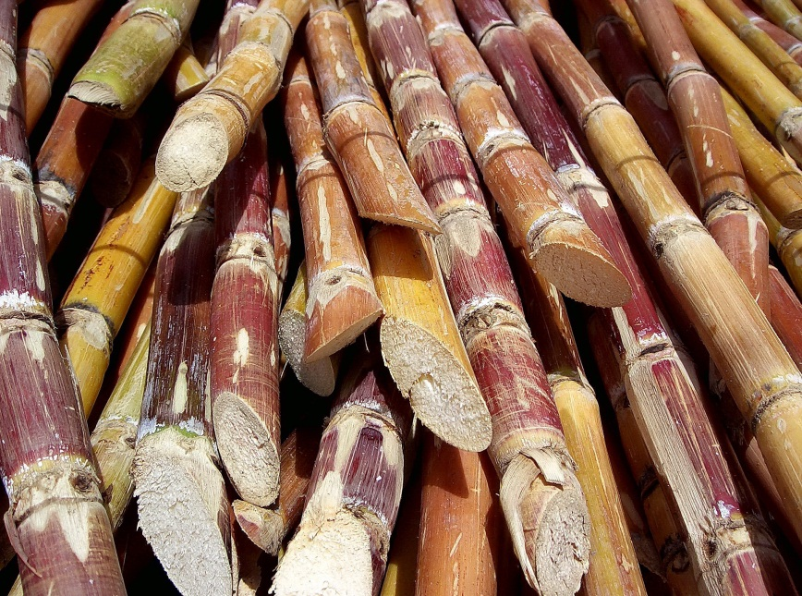
Chapter 5
Sugar
Sugars are found in the tissues of most plants but are only present in sufficient concentrations for efficient extraction in sugarcane and sugar beet.

Slide 30
Chapter 5
Sugar
Production
After harvesting sugar beet, the crop is washed and sliced and the sugar is extracted by diffusion. Milk of lime is added to the raw juice and carbonated in a number of stages in order to purify it. Water is evaporated by boiling the syrup under a vacuum. The syrup is then cooled and seeded with sugar crystals. The white sugar which crystallizes out can be separated in a centrifuge and dried.

Slide 31
Chapter 5
Sugar
Production
Sugar cane is either milled and the juice extracted with water or the sugar is extracted by diffusion. The juice is then clarified with lime and heated to kill enzymes. The resulting thin syrup is concentrated in a series of evaporators after which further water is removed by evaporation in vacuum containers. The resulting supersaturated solution is seeded with sugar crystals and the sugar crystallizes out, is separated from the fluid and dried.

Slide 32
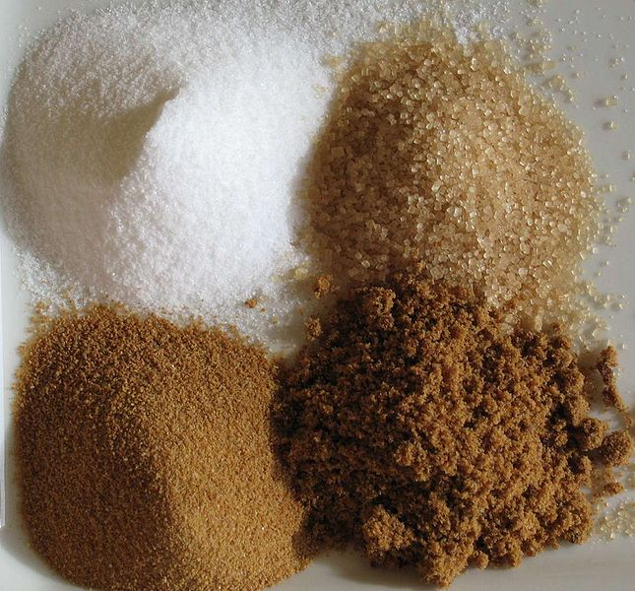
Chapter 5
Sugar
Production
Cane sugar requires further processing to provide the free-flowing white table sugar required by the consumer.

Slide 33
End of the chapter 5

