Slide 1
Chapter 3
Chemical Equilibrium
Table of Contents
Physical Equilibrium
Chemical Equilibrium
Factors Causing Equilibrium
Equilibrium Constant Expression
Factors Affecting Equilibrium

Slide 2
Chapter 3
Chemical Equilibrium
Warm up
Tell about some processes that they go to completion.
Describe what reversible means.
Find a synonym for reversible.

Slide 3
Chapter 3
Chemical Equilibrium
Reactions
Irreversible
Reversible
The one goes completion.
Explosions, burning
processes, decay of
leaves, etc.
The one that can occur in both
the forward and the reverse
directions. Formation of NH₃ , HCl, H₂SO₄.

Slide 4
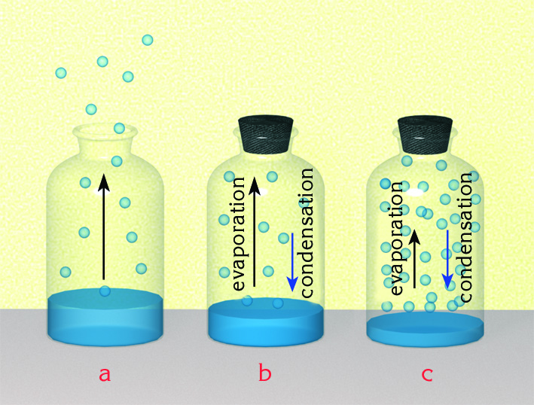
Chapter 3
1. Physical Equilibrium
An equilibrium established by changing states of matter is called physical equilibrium.
H₂O(l) ⇔ H₂O(g)

Slide 5
Chapter 3
1. Physical Equilibrium
H₂O(l) ⇔ H₂O(g)
Vaporization and condensation of water in a closed
container at constant temperature is a physical equilibrium.
When rate of vaporization and rate of condensation become
equal an equilibrium state is established.
At equilibrium the amounts of water vapor and liquid water
remain constant. But evaporation and condensation
continues on microscopic scale. This is called dynamic
equilibrium.

Slide 6
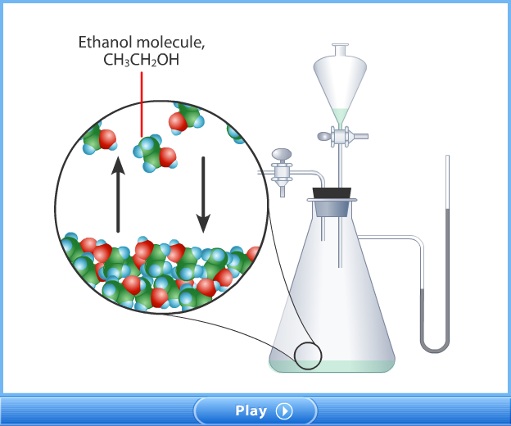
Chapter 3
1. Physical Equilibrium

Slide 7
Chapter 3
2. Chemical Equilibrium
Chemical equilibrium is a state of balance in which the
rate of a forward reaction equals the rate of the reverse
reaction and the concentrations of products and reactants
remain unchanged.
Only a very small fraction of the collisions between H₂ and I₂ result in the formation of HI.
As more HI molecules are made, they collide more often and form H₂ and I₂ by the reverse reaction.

Slide 8
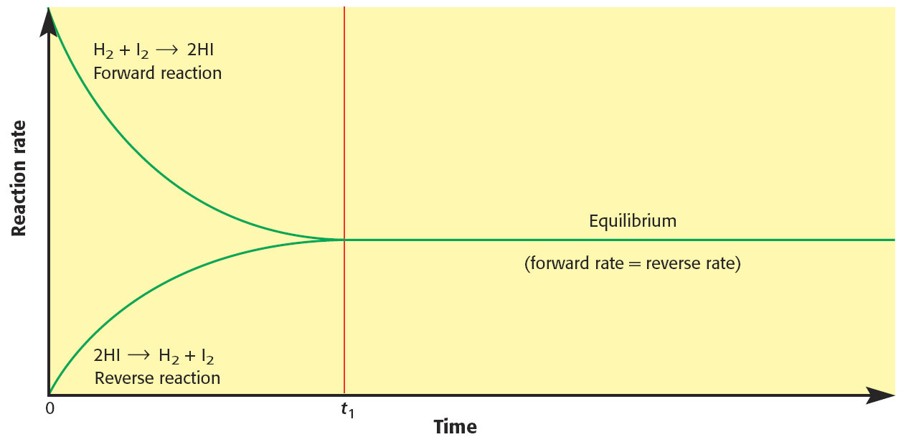
Chapter 3
2. Chemical Equilibrium
Rate Comparison for H₂(g) + I₂(g) ⇔ 2HI(g)
When the forward rate and the reverse rate are equal, the system is at chemical equilibrium.

Slide 9
Chapter 3
2. Chemical Equilibrium
Rate Comparison for H₂(g) + I₂(g) ⇔ 2HI(g)
Concentration, M
When the reaction reaches equilibrium concentration of substances become constant.
H₂ or I₂
HI
t_{eq}
Time

Slide 10
Chapter 3
2. Chemical Equilibrium
Fundamentals of Dynamic Equilibrium
It does not show any visible change.
It reaches through spontaneous change.
Forward and reverse reactions take place continuously.
It must be in a closed system.
Temperature must be kept constant through equilibrium.
Example 1
H₂(g) + Cl₂(g) ⇔ 2HCl(g) (homogeneous)
Mg(s) + 2HCl(aq) ⇔ MgCl₂(aq) + H₂(g) (heterogeneous)

Slide 11
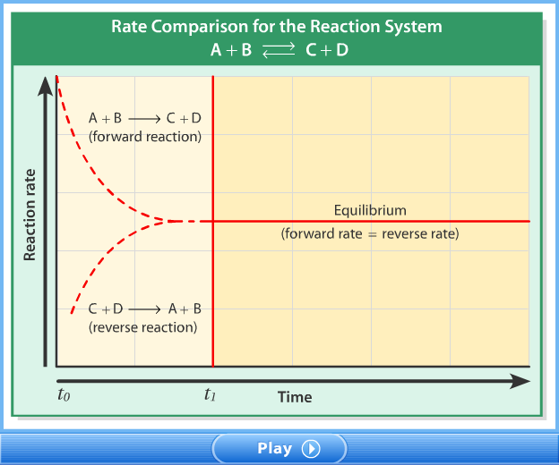
Chapter 3
2. Chemical Equilibrium

Slide 12
Chapter 3
2. Chemical Equilibrium

Slide 13
Chapter 3
3. Factors Causing Equilibrium
There are two opposing factors causing equilibrium in a
chemical reaction;
1.Tendency toward minimum energy
In nature matter tend to lose energy to reach a lower
energy state.
In exothermic reactions direction of minimum energy
is in favor of products.
In endothermic reactions direction of minimum energy is in favor of reactants.

Slide 14
Chapter 3
3. Factors Causing Equilibrium
Example 2
Find the direction of minimum energy in the following
reactions.
N₂O₄(g) ⇔ 2NO₂(g) ∆H=+14 kcal
2O₃(g) ⇔ 3O₂(g) ∆H= - 68 kcal
2NH₃(g) + 22 kcal ⇔ N₂(g) + 3H₂(g)
Solution
a. Reverse b. Forward c. Reverse

Slide 15
Chapter 3
3. Factors Causing Equilibrium
2.Tendency toward maximum randomness (Entropy)
Randomness increase from solid state to gaseous
state.
H₂O(s) ⇔ H₂O(l) ⇔ H₂O(g)
Tendency toward maximum randomness
Randomness is in favor of the side which has more
particles.
2O₃(g) ⇔ 3O₂(g)
Tendency toward maximum randomness
If two tendencies min. energy and max. randomness are in
opposite directions in a reaction the reaction can reach
equilibrium.

Slide 16
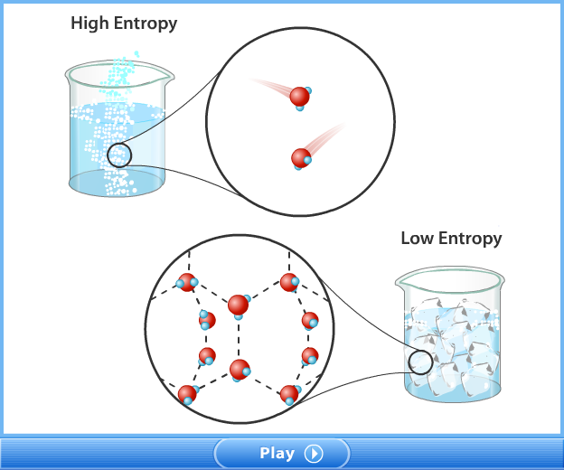
Chapter 3
3. Factors Causing Equilibrium
2.Tendency toward maximum randomness (Entropy)

Slide 17
Chapter 3
3. Factors Causing Equilibrium
Example 3
Find the following reactions whether they can reach
equilibrium or not.
a. N₂O₄(g) → 2NO₂(g) ∆H=+14 kcal
b. Al(s) + 3HCl(aq) → AlCl₃(aq) + 3/2H₂(g) + 68 kcal
c. 2NH₃(g) + 22 kcal → N₂(g) + 3H₂(g)
Solution
a. Yes b. No c. Yes

Slide 18
Chapter 3
4. Equilibrium Constant Expression

Slide 19
Chapter 3
4. Equilibrium Constant Expression

Slide 20
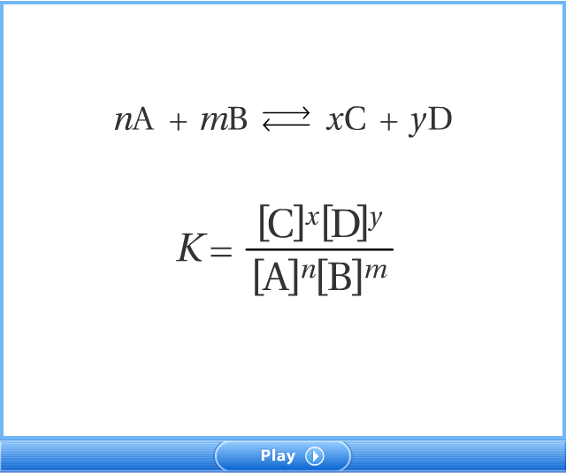
Chapter 3
4. Equilibrium Constant Expression

Slide 21
Chapter 3
4. Equilibrium Constant Expression
Solid and liquid substances are not included in
Kc expressions.
Example 4
Write Kc expressions of the following
equilibrium reactions.
N₂O₄(g) ⇔ 2NO₂(g)
2Mg(s) + O₂(g) ⇔ 2MgO(s)
2NH₃(g) ⇔ N₂(g) + 3H₂(g)
Ag⁺(aq) + Cl⁻(aq) ⇔ AgCl(s)
Solution

Slide 22
Chapter 3
4. Equilibrium Constant Expression
Example 5
The following reaction is allowed to reach equilibrium. X₂(g) + 2Y₂(g) ⇔ 2XY₂(g)
The initial amounts of X₂ and Y₂ gas present in a 2-L container are 2 mol and 6 mol respectively. The amount of XY₂ is 1 mol at equilibrium. What is the value of equilibrium constant Kc?

Slide 23
Chapter 3
4. Equilibrium Constant Expression
Solution
X₂(g) + 2Y₂(g) ⇔ 2XY₂(g)
Initial: 2 mol 6 mol -
Change: -0.5 mol -1 mol + 1 mol
At equilibrium: 1.5 mol 5 mol 1 mol
Concentrations: 1.5/2 M 5/2 M ½ M
0.75 M 2.5 M 0.5 M

Slide 24
Chapter 3
4. Equilibrium Constant Expression
Example 6
A 0.80 g sample of SO₃ placed in a 1.00 liter container decomposes 80% to establish equilibrium represented by the equation
2SO_{3(g)} ⇔ 2SO_{2(g)} + O_{2(g)} at 1100 K.
Calculate Kc for this reaction. (S:32, O:16)

Slide 25
Chapter 3
4. Equilibrium Constant Expression
Solution
n_{i} = 0.8/80= 0.01 mol
n_{eq}= 0.01 – 0.01x0.80 (80%decomposes) = 0.002 mol
2SO_{3(g)} ⇔ 2SO_{2(g)} + O_{2(g)}
Initial: 0.01 mol - -
Change: - 0.008 mol +0.008 mol + 0.004 mol
At equilibrium 0.002 mol 0.008 mol 0.004 mol
Concentrations 0.002/1 M 0.008/1 M 0.004/1 M

Slide 26
Chapter 3
4. Equilibrium Constant Expression
Example 7
For the equilibrium system described by:
PCl_{5 (g)} ⇔ PCl_{3 (g)} + Cl_{2 (g)}
K_{eq} equals 35 at 487°C. If the concentrations of the PCl₅ and PCl₃ at equilibrium are 0.015 M and 0.78 M, respectively, what is the concentration of the Cl₂?
Solution

Slide 27
Chapter 3
4. Equilibrium Constant Expression
Example 8
At a certain temperature the Kc for the equilibrium system below is 4.
H_{2(g)} + CO_{2 (g)} ⇔ H₂O_{(g)} + CO _{(g)}
Calculate the concentration of each substance in the equilibrium obtained by mixing 0.6 mol of each of H₂ and CO₂ in a 5 – L box?
If the equilibrium were obtained by mixing 0.6 mol H₂O and 0.6 mol CO what would be the equilibrium concentration of each species? Compare your results for part a and b.

Slide 28
Chapter 3
4. Equilibrium Constant Expression
Solution
a. H_{2(g)} + CO_{2 (g)} ⇔ H₂O_{(g)} + CO _{(g)}
Initial: 0.6 mol 0.6 mol - -
Change: -x mol -x mol +x mol +x mol
At equilibrium 0.6 - x 0.6 - x mol x mol x mol
Concentrations (0.6–x)/5 M (0.6–x)/5 M x/5 M x/5 M
[H₂] = [CO₂] = (0.6–0.4)/5 M = 0.04 M
[H₂O] = [CO] = 0.4/5 M = 0.08 M

Slide 29
Chapter 3
4. Equilibrium Constant Expression
Solution
b. H_{2(g)} + CO_{2 (g)} ⇔ H₂O_{(g)} + CO _{(g)}
Initial: - - 0.6 mol 0.6 mol
Change: +x mol +x mol -x mol -x mol
At equilibrium +x +x mol 0.6-x mol 0.6-x mol
Concentrations x/5 M x/5 M (0.6–x)/5 M (0.6–x)/5 M
[H₂] = [CO₂] =0.2/5 M = 0.04 M
[H₂O] = [CO] = (0.6-0.2)/5 M = 0.08 M

Slide 30
Chapter 3
4. Equilibrium Constant Expression
Example 9
A 3 mol sample of N₂O₅ was placed and heated in a 1-L vessel. Some of N₂O₅ decomposed according to the reaction,
2N₂O_{5(g)} ⇔ 4NO_{2(g)} + O_{2 (g)}
At equilibrium the total mole number of gases was found to be
3.75. Calculate the value of Kc for this reaction.

Slide 31
Chapter 3
4. Equilibrium Constant Expression
Solution
2N₂O_{5(g)} ⇔ 4NO_{2(g)} + O_{2 (g)}
Initial: 3 mol - -
Change: -x mol +2x mol +0.5x mol At equilibrium: 3-x mol 2x mol 0.5x mol
n_{t} = 3-x+2x+0.5x = 3.75 mol ⇒ x = 0.5 mol
Equilibrium concentrations: [N₂O₅] = 3-0.5 = 2.5 M,
[NO₂] = 2.(0.5) = 1 M, [O₂] = (0.5).(0.5) = 0.25 M

Slide 32
Chapter 3
4. Equilibrium Constant Expression
The relation Between Kp and Kc
aA(g) + bB(g) ⇔ cC(g) + dD(g)
Kp = Kc (RT)^{Δn}
Where Δn = (c + d) – (a+b)
If Δn = 0, then Kp = Kc
Example 10
Find Kp and Kc relationship for the reaction below.
2CO(g) + O₂(g) ⇔ 2CO₂(g)
Solution
Kp = Kc (RT)²⁻⁽²⁺¹⁾ ⇒ Kp = Kc (RT)⁻¹

Slide 33
Chapter 3
4. Equilibrium Constant Expression
Example 11
Find Kp and Kc relationship for the reactions below.
H₂(g) + I₂(g) ⇔ 2HI(g)
C(s) + H₂O(g) ⇔ CO(g) + H₂(g)
CO(g) + 2H₂(g) ⇔ CH₃OH(g)
N₂O₄(g) ⇔ 2NO₂(g)
Example 12
4 moles of NH₃ in a 2-L vessel is allowed to come equilibrium at
a total pressure of 3.6 atm. The number of mole of N₂(g) in the
equilibrium mixture is measured to be 1 mol. What is the Kp for
the following reaction below?
2NH₃(g) ⇔ N₂(g) + 3H₂(g)

Slide 34
Chapter 3
4. Equilibrium Constant Expression
Solution
2NH₃(g) ⇔ N₂(g) + 3H₂(g)
Initial: 4 mol - -
Change: -2 mol +1 mol +3 mol At equilibrium: 2 mol 1 mol 3 mol
Concentrations: 2/2 M ½ M 3/2 M
PV = n_{t}RT ⇒ 3.6x2 = 6xRT ⇒ RT = 1.2
Kp = Kc(RT)^{Δn} ⇒ Kp = 1.6875(1.2)⁽¹⁺³⁾ ⁻² = 2.43

Slide 35
Chapter 3
4. Equilibrium Constant Expression
Variation of Kc Expression
The value of Kc changes by altering the reaction in different ways.
The equilibrium constant for the forward and reverse
reactions are the reciprocal of each other.
2CO(g) + O₂(g) ⇔ 2CO₂(g) Kc
For the reverse reaction;
2CO₂(g) ⇔ 2CO(g) + O₂(g)

Slide 36
Chapter 3
4. Equilibrium Constant Expression
If the coefficient of a reaction equation are multiplied by a
number; the equilibrium constant is raised to the power of that
number.
2CO(g) + O₂(g) ⇔ 2CO₂(g) Kc
For the reaction;
4CO(g) + 2O₂(g) ⇔ 4CO₂ (g)

Slide 37
Chapter 3
4. Equilibrium Constant Expression
If a reaction equation is expressed as a sum of two or more
reaction equations, Kc for the overall reaction is the product of
the equilibrium constants of individual reactions.
CO₂(g) ⇔ CO(g) + 1/2O₂(g) Kc₁
H₂(g) + 1/2O₂(g) ⇔ H₂O(g) Kc₂
H₂(g) + CO₂(g) ⇔ H₂O(g) + CO(g) Kc = Kc₁ x Kc₂

Slide 38
Chapter 3
4. Equilibrium Constant Expression
Example 13
Suppose that the Kc for the reaction below is 4 at a certain
temperature.
A₂(g) + 1/2B₂(g) ⇔ A₂B(g)
2A₂(g) + B₂(g) ⇔ 2A₂B(g)
3A₂B(g) ⇔ 3A₂(g) + 3/2B₂(g)
1/2A₂B(g) ⇔ 1/2A₂(g) +1/4B₂(g)

Slide 39
Chapter 3
4. Equilibrium Constant Expression
Solution
A₂(g) + 1/2B₂(g) ⇔ A₂B(g) Kc = 4
2A₂(g) + B₂(g) ⇔ 2A₂B(g)
Kc` = (Kc)² = 4² = 16
3A₂B(g) ⇔ 3A₂(g) + 3/2B₂(g)
Kc` = (1/Kc)³ = (¼)³ = 1/64 = 0.0156
1/2A₂B(g) ⇔ 1/2A₂(g) +1/4B₂(g)
Kc` = (1/Kc)^{1/2} = (1/4)^{1/2} = ½ = 0.5

Slide 40
Chapter 3
4. Equilibrium Constant Expression
Example 14
At a certain temperature:
(I) SO₃(g) + NO(g) ⇔ SO₂(g) + NO₂(g) Kc₁ = 0.25
(II) NO(g) + 1/2O₂(g) ⇔ NO₂(g) Kc₂ = 2
Find the value of Kc for the reaction below at the same
temperature.
SO₂(g) + 1/2O₂(g) ⇔ SO₃(g)

Slide 41
Chapter 3
4. Equilibrium Constant Expression
Solution
I reaction must be reversed.
(I) SO₂(g) + NO₂(g) ⇔ SO₃(g) + NO(g) Kc₁ = 1/0.25
(II) NO(g) + 1/2O₂(g) ⇔ NO₂(g) Kc₂= 2
SO₂(g) + 1/2O₂(g) ⇔ SO₃(g) Kc = Kc₁x Kc₂
= 1/0.25x2
= 8

Slide 42
Chapter 3
4. Equilibrium Constant Expression
The Reaction Quotient, Qc
Qc helps us predict the direction in which a reaction mixture
will proceed to reach equilibrium. Kc is determined when the
reaction is at equilibrium at constant temperature. Qc is
determined when the reaction is at non equilibrium conditions.
Qc = Kc, then the reaction is at equilibrium.
Qc>Kc , then the reverse reaction takes place to establish equilibrium.
Qc<Kc, then the forward reaction takes place to establish equilibrium.

Slide 43
Chapter 3
4. Equilibrium Constant Expression
Example 15
1 mol of H₂, 1 mol of I₂ and 2 mol of HI are placed into a
one liter container at a certain temperature to establish the
equilibrium
H₂(g) + I₂(g) ⇔ 2HI(g). Kc = 64
What will be the equilibrium concentration of each species, if
Kc is 64 at this temperature?

Slide 44
Chapter 3
4. Equilibrium Constant Expression
Solution
H₂(g) + I₂(g) ⇔ 2HI(g)
Initial: 1 mol 1 mol 2 mol
Change: -x mol -x mol +2x mol
At equilibrium 1- x mol 1 - x mol 2+2x mol
Concentrations 1-x M 1-x M 2+2x M
[HI] = 2+2.(0.6) = 3.2 M, [H₂] = [I₂] = 1-0.6 = 0.4 M

Slide 45
Chapter 3
4. Equilibrium Constant Expression
Example 16
The equilibrium constant, Kc, is 36 at a certain
temperature for the reaction,
CO(g) + H₂O(g) ⇔ CO₂(g) + H₂(g).
Predict the direction in which the reaction will proceed to
reach equilibrium if it is started with 0.5 mol of CO, 0.5 mol of
H₂O, 5 mol of CO₂ and 5 mol of H₂ in a 5-L vessel.

Slide 46
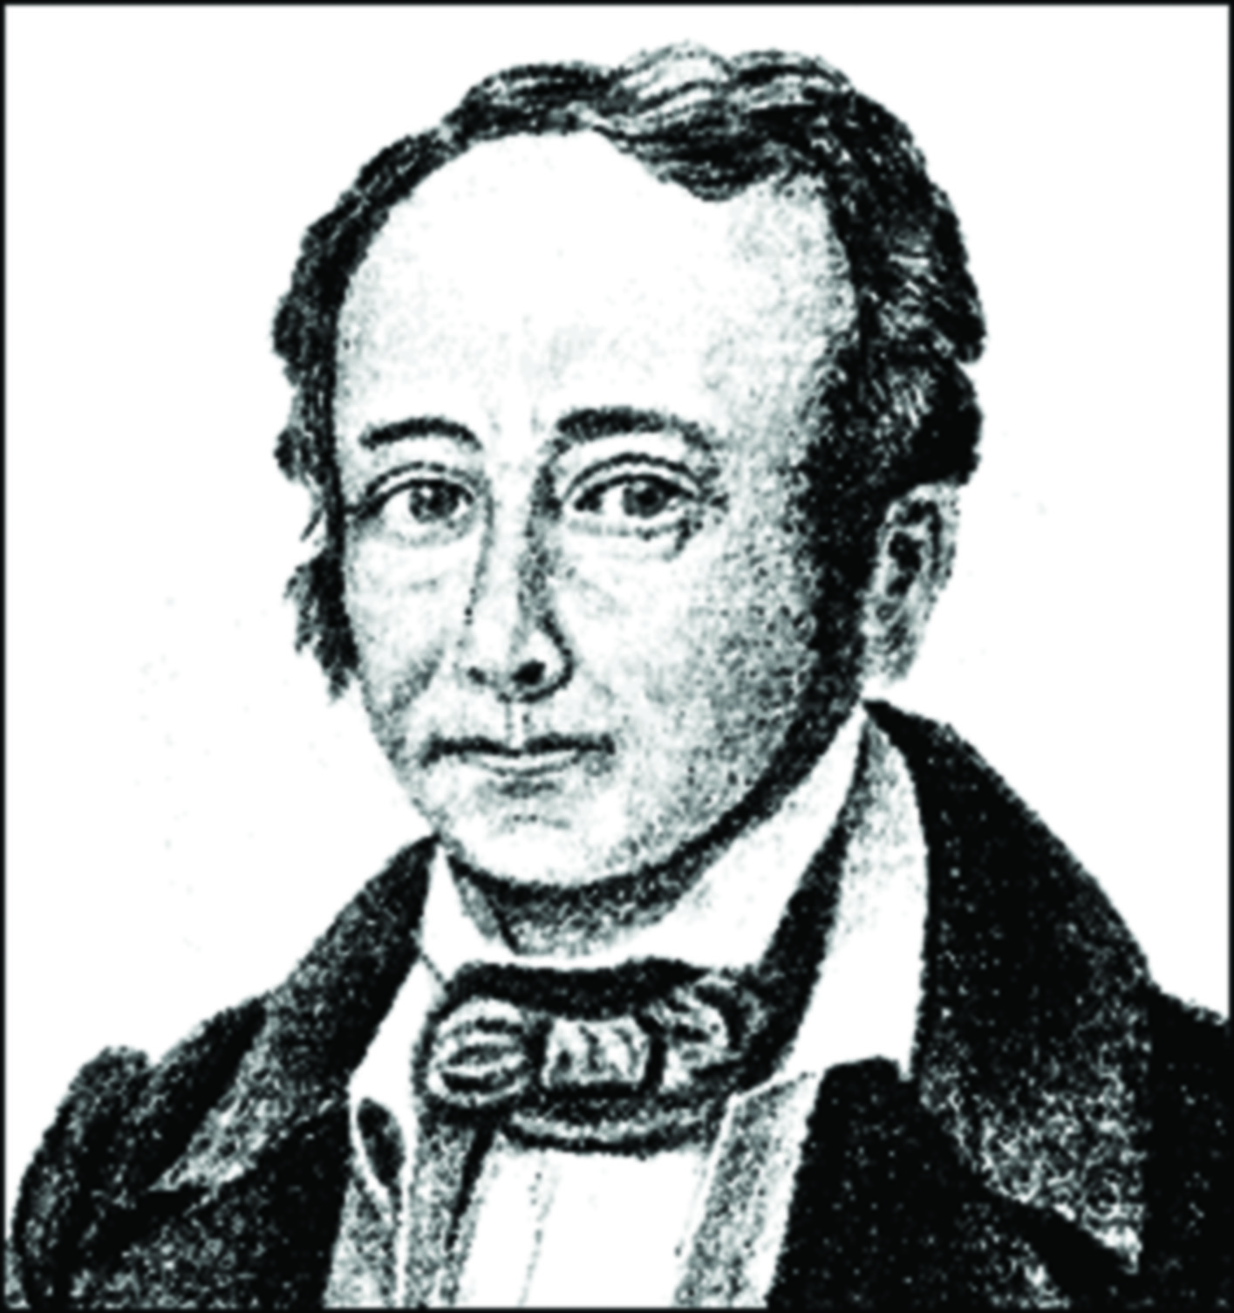
Chapter 3
5. Factors Affecting Equilibrium
(Le Chatelier’s Principle)
If a chemical system at equilibrium is
disturbed by a change of concentration,
pressure, or temperature, system tends to
counteract this change in order to
reestablish a new equilibrium. This principle is called
Le Chatelier’s principle, suggested by Henry Le Chatelier,
French Scientist, professor of Chemistry at University of
Paris.

Slide 47
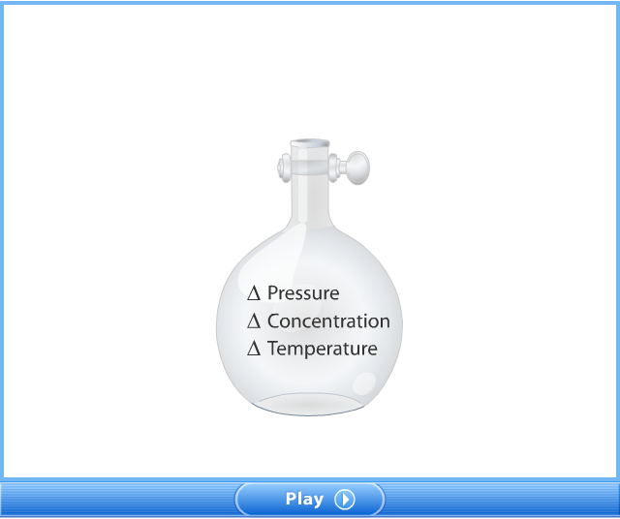
Chapter 3
5. Factors Affecting Equilibrium
(Le Chatelier’s Principle)

Slide 48
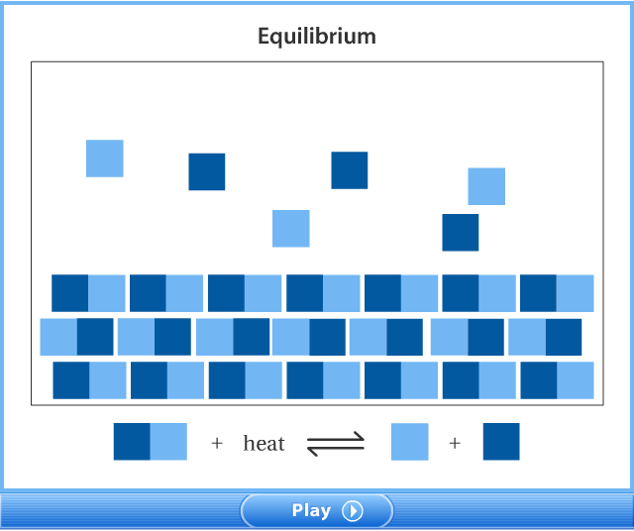
Chapter 3
5. Factors Affecting Equilibrium
(Le Chatelier’s Principle)

Slide 49
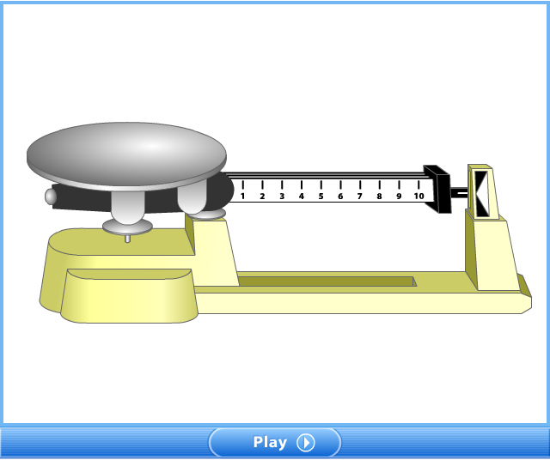
Chapter 3
5. Factors Affecting Equilibrium
(Le Chatelier’s Principle)

Slide 50
Chapter 3
5. Factors Affecting Equilibrium
(Le Chatelier’s Principle)

Slide 51
Chapter 3
5. Factors Affecting Equilibrium
(Le Chatelier’s Principle)
1. The Effect of Concentration
For the effect of concentration there are four cases:
Following reaction is given below;
N₂(g) + 3H₂(g) ⇔ 2NH₃(g) at equilibrium at 25ºC.
a. If some N₂ or H₂ is added to reaction container, the system is disturbed and it will try to decrease this effect by moving forward, then the reaction will reestablish a new equilibrium. As a result of this, concentration of NH₃ will increase.
b. If some NH₃ is added the reaction will try to minimize this effect by moving backward. As a result concentration of both N₂ and H₂ will increase.

Slide 52
Chapter 3
5. Factors Affecting Equilibrium
(Le Chatelier’s Principle)
1. The Effect of Concentration
N₂(g) + 3H₂(g) ⇔ 2NH₃(g) at equilibrium at 25ºC.
c. If some N₂ or H₂ is removed, decreasing concentration, from reaction container, the system is disturbed and it will try to decrease this effect by moving backward, then the reaction will reestablish a new equilibrium. As a result of this, concentration of NH₃ will decrease.
d. If some NH₃ is removed from the reaction container the reaction will try to minimize this effect by moving forward. As a result concentration of both N₂ and H₂ will decrease.

Slide 53
Chapter 3
4. Equilibrium Constant Expression
Example 17
The following reaction at equilibrium is given, at 25ºC.
CO(g) + H₂O(g) ⇔ CO₂(g) + H₂(g).
Following changes are applied. Try to predict how the reaction
respond to the these effects.
Addition of CO gas,
Addition of H₂ gas,
Removal of H₂O gas,
Removal of CO₂ gas.

Slide 54
Chapter 3
4. Equilibrium Constant Expression
Solution
CO(g) + H₂O(g) ⇔ CO₂(g) + H₂(g).
The reaction shifts forward, and concentration of CO₂ and H₂ will increase and concentration of H₂O will decrease.
The reaction shifts backward, and concentration of H₂O and CO will increase and concentration of CO₂ will decrease.
The reaction shifts backward, and concentration of CO₂ and H₂ will decrease and concentration of CO will increase.
The reaction shifts forward, and concentration of CO and H₂O will decrease and concentration of H₂ will increase.

Slide 55
Chapter 3
4. Equilibrium Constant Expression
Example 18
Consider the reaction:
2HI(g) ⇔ H₂(g) + I₂(g)
An equilibrium mixture was found to contain 2 mol of HI, 1 mol
of H₂ and 1 mol of I₂ in a 2-L vessel. At the same temperature
1 mol of HI is added to the vessel. Calculate the concentration
of each substance when new equilibrium is established.

Slide 56
Chapter 3
4. Equilibrium Constant Expression
Solution
[HI] = 2/2 = 1 M, [H₂] =[I₂] = ½ =0.5 at equilibrium.
2HI(g) ⇔ H₂(g) + I₂(g)
1st Eq: 1 M 0.5 M 0.5 M
Effect : +0.5 M - -
Change: -2x +x +x
At 2nd Eq: 1.5 -2x 0.5+x 0.5+x
[HI] = 1.5 -2(0.125) = 1.25 M, [H₂] = [I₂] = 0.5+0.125 = 0.625 M

Slide 57
Chapter 3
5. Factors Affecting Equilibrium
(Le Chatelier’s Principle)
2. Volume Changes or Effect of Pressure
Change in volume alters the concentrations of gas reactants and gas products.
According to Le Chatelier’s principle, when the volume of the system is decreased; the reaction shifts to the side having the smaller number of coefficients of gases to decrease this effect.
When the volume of the system is increased; the reaction shifts to the side having the greater number of coefficients of gases to decrease this effect.

Slide 58
Chapter 3
5. Factors Affecting Equilibrium
(Le Chatelier’s Principle)
2. Volume Changes or Effect of Pressure
For heterogeneous equilibrium the effect of volume is predicted by counting the number of moles of gas indicated on each side of an equation.
Change in pressure affects the equilibrium reaction conversely with respect to volume change.

Slide 59
Chapter 3
4. Equilibrium Constant Expression
Example 19
Consider the reaction:
2NH₃(g) ⇔ 3H₂(g) + N₂(g)
Following changes are applied. Try to predict how the reaction
respond to the these effects.
Increasing volume,
Decreasing volume,
Increasing pressure.

Slide 60
Chapter 3
4. Equilibrium Constant Expression
Solution
2NH₃(g) ⇔ 3H₂(g) + N₂(g)
2 mol gas reactant 4 mol gas product
The reaction shifts forward, and concentration of H₂ and N₂ will increase and that of NH₃ will decrease.
The reaction shifts backward, and concentration of H₂ and N₂ will decrease and that of NH₃ will increase.
Increasing pressure means decreasing volume. Thus it will have same effect in b.

Slide 61
Chapter 3
4. Equilibrium Constant Expression
Example 20
Consider the reaction:
CaCO₃(s) ⇔ CO₂(g) + CaO(s)
Following changes are applied. How the reaction will the
reaction shift to reestablish equilibrium.
Increasing pressure,
Decreasing volume,
Increasing volume.

Slide 62
Chapter 3
4. Equilibrium Constant Expression
Solution
CaCO₃(s) ⇔ CO₂(g) + CaO(s)
0 mol gas reactant 1 mol gas product
Increasing pressure means decreasing volume. The reaction shifts backward.
The reaction shifts backward.
The reaction shifts forward.

Slide 63
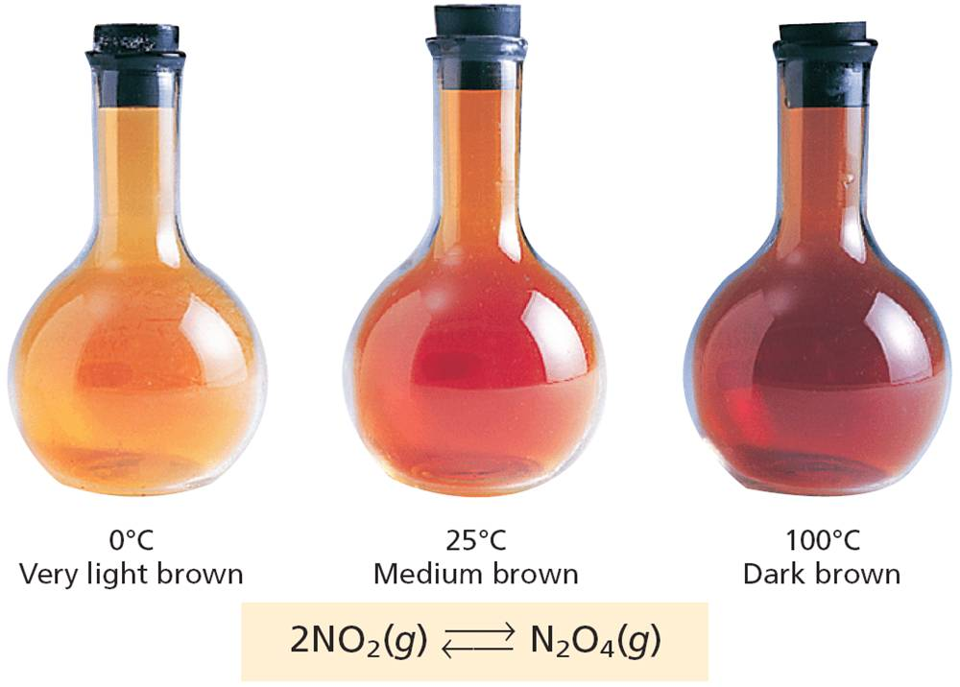
Chapter 3
5. Factors Affecting Equilibrium
(Le Chatelier’s Principle)
3. Effect of Temperature
Effect of temperature can be understood by knowing whether the reaction is exothermic or endothermic.
In endothermic reactions when temperature is increased the reaction will proceed to forward to eliminate effect.
In exothermic reactions when temperature is increased the reaction will move backward to minimize effect.

Slide 64
Chapter 3
4. Equilibrium Constant Expression
Example 21
Consider the reaction:
2H₂O(g) ⇔ 2H₂(g) + O₂(g) ΔH = +136.6 kcal
Following changes are applied. How the reaction will the
reaction shift to reestablish equilibrium.
Increasing temperature,
Decreasing temperature.

Slide 65
Chapter 3
4. Equilibrium Constant Expression
Solution
2H₂O(g) ⇔ 2H₂(g) + O₂(g) ΔH = +136.6 kcal
The reaction is endothermic.
Forward reaction needs energy to take place, if temperature is increased it will be in favor of forward reaction. The reaction will shift forward.
Reverse reaction is exothermic. If temperature is decreased it will be in favor of reverse reaction. The reaction will shift backward.

Slide 66
Chapter 3
5. Factors Affecting Equilibrium
(Le Chatelier’s Principle)
4. Effect of Catalyst
Catalyst does not effect equilibrium reactions and Kc.
They effect both forward and reverse reactions equally, therefore they cause the reactions to reach equilibrium in a shorter time.

Slide 67
End of the chapter 3

