Slide 1
Chapter 1
Chemical Reactions and Heat
Table of Contents
Endothermic and Exothermic Reactions
Enthalpy Change of Reactions
Calorimeters
Bond Energies
Hess’ Law

Slide 2
Chapter 2
1. Endothermic and Exothermic Reactions
Warm up
Look at words below
Heat Temperature
Write a definition for each of these words and describe how they are related.
How do you understand these words related with chemical reactions?

Slide 3
Chapter 1
1. Endothermic and Exothermic Reactions
Thermo chemistry is the study of heat changes that accompany chemical reactions and phase changes.
In chemical reactions energy is either absorbed or released. According to this there are two types of reactions; endothermic and exothermic.
Endothermic Reactions
Energy is absorbed by reactants and total potential
energy of reactants is smaller than that of products.

Slide 4
Chapter 1
1. Endothermic and Exothermic Reactions
The reaction above is an example for endothermic
reactions.

Slide 5
Chapter 1
1. Endothermic and Exothermic Reactions
Exothermic Reactions
Energy is released by reactants and total potential
energy of reactants is greater than that of products.

Slide 6
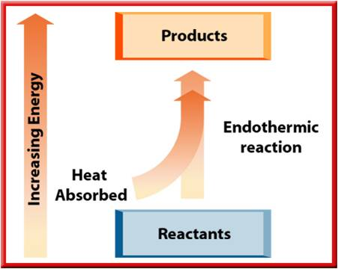
Chapter 1
1. Endothermic and Exothermic Reactions

Slide 7
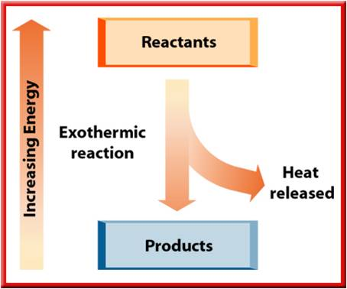
Chapter 1
1. Endothermic and Exothermic Reactions

Slide 8

Chapter 1
1. Endothermic and Exothermic Reactions

Slide 9
Chapter 1
1. Endothermic and Exothermic Reactions

Slide 10
Chapter 1
2. Enthalpy Change of Reactions (ΔH)
Enthalpy (H) is the heat content of a substance at constant pressure.
The change in enthalpy for a reaction is called the enthalpy of reaction (∆H).
ΔH = ΣH_{products} - ΣH_{reactants}
If ΣH_{products} > ΣH_{reactants}, then ∆H > 0 so the reaction is endothermic. Similarly,
If ΣH_{products} < ΣH_{reactants}, then ∆H < 0 so the reaction is exothermic.

Slide 11
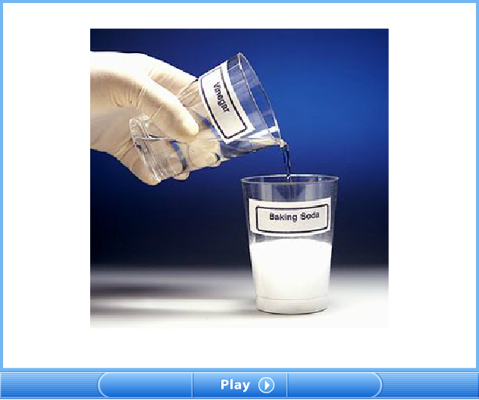
Chapter 1
2. Enthalpy Change of Reactions (ΔH)

Slide 12
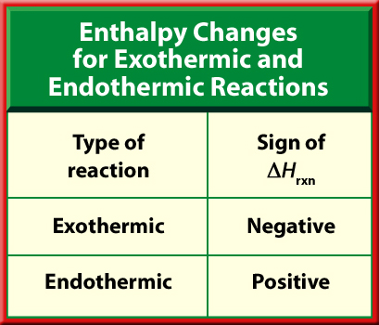
Chapter 1
2. Enthalpy Change of Reactions (ΔH)

Slide 13
Chapter 1
2. Enthalpy Change of Reactions (ΔH)
Example 1
ΔH = - 393.5 kJ < 0 then the reaction is exothermic.

Slide 14
Chapter 1
2. Enthalpy Change of Reactions (ΔH)
Example 2
ΔH = 242 kJ > 0 then the reaction is endothermic.

Slide 15
Chapter 1
2. Enthalpy Change of Reactions (ΔH)
Standard Heat of Formation (ΔHº_{f})
The heat change when 1 mole compound is produced
from its elements in their most stable states (under 1 atm
pressure and at 25ºC) is called as standard heat of
formation, and shown by ΔHº_{f} .
ΔHº_{f} of the free atoms (K, Fe, Na, S, P, Cu…etc) and
free simple molecules (O₂, N₂, Cl₂, P₄, …etc) are accepted
as zero.

Slide 16
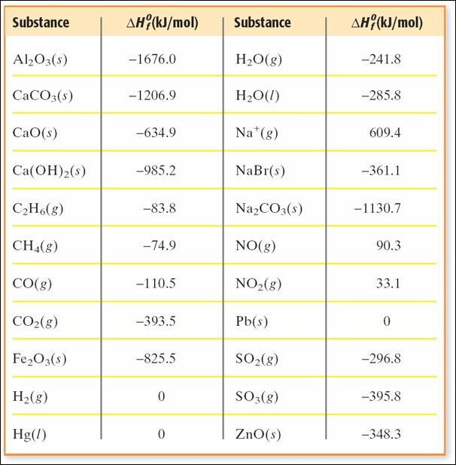
Chapter 1
2. Enthalpy Change of Reactions (ΔH)

Slide 17
Chapter 1
2. Enthalpy Change of Reactions (ΔH)
Heat of a reaction, ΔHº can be calculated by using ΔHº_{f} values.
ΔHº = ΣHº_{f(products )} - ΣHº_{f(reactants)}
Example 3
Find the heat of the reaction (ΔHº)
SO₂(g) + ½ O₂(g) → SO₃(g)
by using ΔHº_{f} of the compounds given
  ΔHº_{f(SO2)} = -297 kJ/mol,
  ΔHº_{f(SO3)} = -396 kJ/mol,
  ΔHº_{f(O2)} = 0 kJ/mol.

Slide 18
Chapter 1
2. Enthalpy Change of Reactions (ΔH)
Solution
ΔHº = ΣHº_{f(products )} - ΣHº_{f(reactants)}
ΔHº = ΔHº_{f(SO3)} – [ΔHº_{f(SO2)} + ½ ΔHº_{f(O2)} ]
ΔHº = (-396) – [(-297)+ ½ x (0)]
ΔHº = -99 kJ
Example 4
When 2.4 g of graphite burnt with O₂ completely, 78.70 kJ
heat is released. What is the molar enthalpy of the formation
of CO₂ ?

Slide 19
Chapter 1
2. Enthalpy Change of Reactions (ΔH)
Solution
C_{(graphite)} + O₂(g) → CO₂(g)
2.4 g C releases 78.70 kJ
12 g (1mol) C releases x
x = 393.5 kJ
ΔHº = ΣHº_{f(products )} - ΣHº_{f(reactants)}
ΔHº = ΔHº_{f(CO2)} – [ΔHº_{f(C)} + ΔHº_{f(O2)} ]
-393.5 = ΔHº_{f(CO2)} – [(0)+ (0)]
ΔHº_{f(CO2)} = -393.5 kJ

Slide 20
Chapter 1
2. Enthalpy Change of Reactions (ΔH)
Example 5
The combustion reaction of propane is
C₃H₈(g) + 5O₂(g) → 3CO₂(g) + 4H₂O(l) ΔHº = -2220.3 kJ
If ΔHº_{f(CO2)} and ΔHº_{f(H2O)} values are -393.5 kJ/mol and -286
kJ/mol respectively find ΔHº_{f(C3H8)} ?
Example 6
Fe₂O₃(s) + 3CO(g) → 2Fe(s) + 3CO₂(g)
If ΔHº_{f(Fe2O3)} , ΔHº_{f(CO)} and ΔHº_{f(CO2)} values are -826 kJ/mol,
-110.5 kJ/mol and -393.5 kJ/mol respectively find ΔHº for the
reaction.

Slide 21
Chapter 1
2. Enthalpy Change of Reactions (ΔH)
According to types of reactions, there are different types
of enthalpies of reactions. For example heat of combustion,
heat of neutralization and heat of dissolution.
Example 7
What is the molar heat of combustion of propene (C₃H₆), if 343
kJ heat is liberated when 7 g of C₃H₆ is burnt?
Example 8
When some amount of NaOH is dissolved in 200 mL of water,
8.6 kJ heat is produced. What is the concentration of the
solution in M, if ΔHº_{dissolution} = -43 kJ/mol?

Slide 22
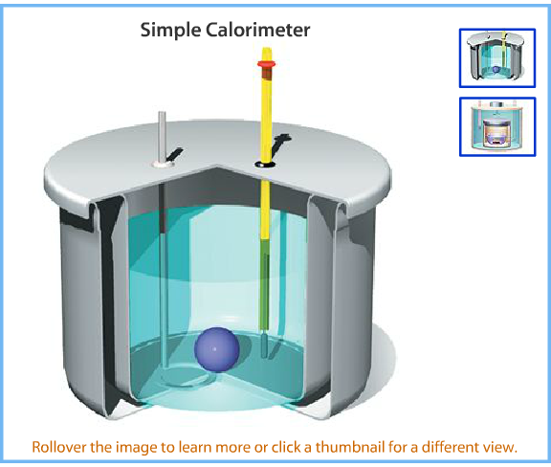
Chapter 1
3. Calorimeters
Calorimeters are devices to measure heats of reactions
(enthalpy change)

Slide 23
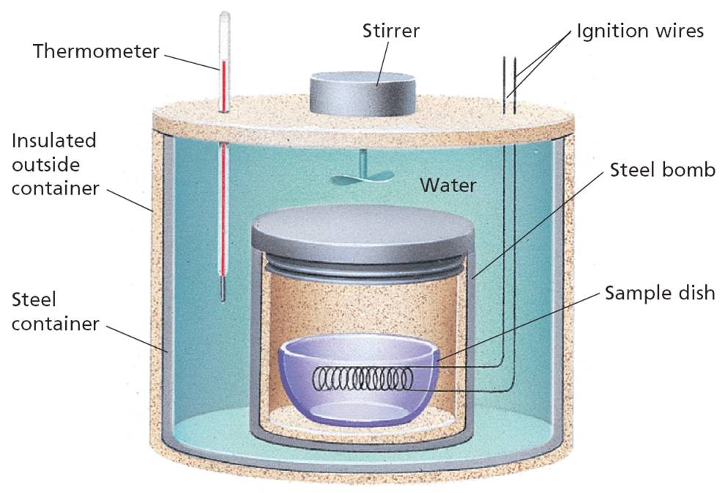
Chapter 1
3. Calorimeters

Slide 24
Chapter 1
3. Calorimeters
In a bomb calorimeter heat of the reaction is calculated
by the following formula.
Heat of reaction = Heat absorbed + Heat absorbed
by bomb by water
Q_{reaction} = - [Q_{bomb} + Q_{water}] exothermic process
ΔQ_{bomb} = C_{bomb} . ΔT
ΔQ_{water} = C_{water} . ΔT
ΔQ_{reaction} = - (C_{bomb}. ΔT + C_{water} . ΔT)
= - (C_{bomb} + C_{water}) . ΔT
Q_{reaction} = - C_{calorimeter} . ΔT

Slide 25
Chapter 1
3. Calorimeters
Example 9
When a 0.5 g of benzene (C₆H₆) is burnt in a bomb
calorimeter, the temperature of the calorimeter rises from
25ºC to 33.52ºC. If the molar heat of benzene is 3189.9 kJ ,
find the heat capacity of the calorimeter?
Solution
C₆H₆ + 15/2 O₂ → 6CO₂ + 3H₂O
ΔHº_{combustion} = -3189.9 kJ/mol
78 g (1mol) C₆H₆ releases 3189.9 kJ
0.5 g releases x kJ
x = 20.45 kJ

Slide 26
Chapter 1
3. Calorimeters
Solution
Q_{reaction} = - C_{calorimeter} . ΔT
20.45 = - C_{calorimeter} . (33.52 – 25) C_{calorimeter} = 2.4 kj/ºC
Example 10
When a 10 g of glucose (C₆H₁₂O₆) is burnt in a bomb
calorimeter, what will be the change in the temperature of
the calorimeter? (ΔHº_{combustion} of glucose = -2808 kJ/mol,
and C_{calorimeter} = 6.1 kJ/ºC)

Slide 27
Chapter 1
4. Bond Energies
The energy that is used to break up 1 mol of covalent
bond of a molecule in gaseous state is called Bond Energy.
ΔH = ΣH_{bond} _{breakage} + ΣH_{bond formation}
Bond breakage is endothermic and bond formation is
exothermic processes.

Slide 28
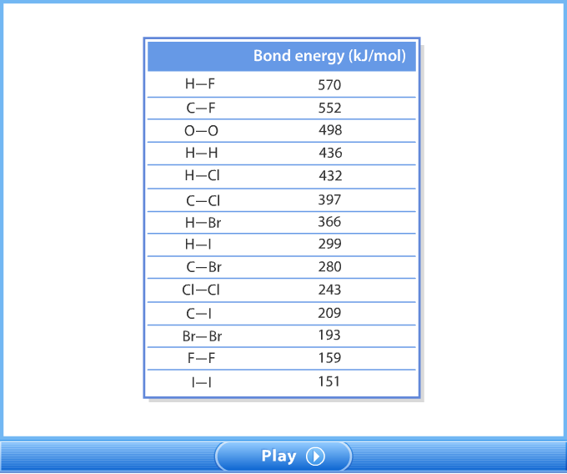
Chapter 1
4. Bond Energies

Slide 29
Chapter 1
4. Bond Energies
Example 10
Find the molar heat of combustion of CH₃CH₂OH by using
bond energies?
Solution
CH₃CH₂OH + 3O₂ → 2CO₂ + 3H₂O ΔHº_{combustion} = ?

Slide 30
Chapter 1
4. Bond Energies
Solution
ΔH = ΣH_{bond} _{breakage} + ΣH_{bond formation}
= 4868 – 5638
= - 770 kj/mol

Slide 31
Chapter 1
5. Hess’s Law
Hess’s law states that the overall enthalpy change in a reaction is equal to the sum of the enthalpy changes for the individual steps in the process.
P₄(s) + 10Cl₂(g) → 4PCl₅(g) ΔH = -1596 kJ
The reaction may occur in two steps as follows.
Step 1: P₄(s) + 6Cl₂(g) → 4PCl₃(g) ΔH = -1224 kJ
Step 2: PCl₃(g) + Cl₂(g) → PCl₅(g) ΔH = -93 kJ

Slide 32
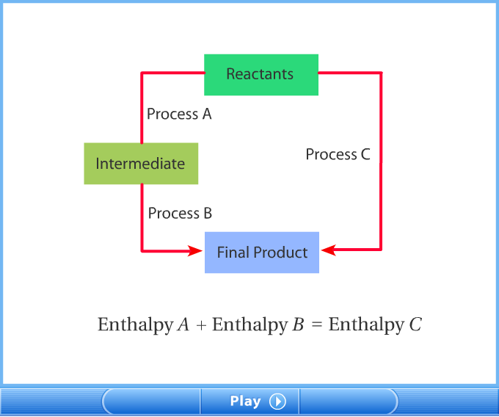
Chapter 1
5. Hess’s Law

Slide 33
Chapter 1
5. Hess’s Law
When equations are added or subtracted, enthalpy changes must be added or subtracted.
When equations are multiplied by a constant, the enthalpy changes must also be multiplied by that constant.
Example 11
Calculate the enthalpy of the formation of pentane, C₅H₁₂,
5C(s) + 6H₂(g) → C₅H₁₂(g) ΔH = ?
using the given information below.
(1) C(s) + O₂(g) → CO₂(g) ΔH = -393.5 kJ/mol
(2) H₂(g) + ½O₂(g) → H₂O(l) ΔH = -285.8 kJ/mol
(3) C₅H₁₂(g) + 8O₂(g) → 5CO₂(g) + 6H₂O(l) ΔH = -3535.6 kJ/mol

Slide 34
Chapter 1
5. Hess’s Law
Solution
(1) C(s) + O₂(g) → CO₂(g) ΔH = -393.5 kJ/mol
(2) H₂(g) + O₂(g) → H₂O(l) ΔH = -285.8 kJ/mol
(3) 5CO₂(g) + 6H₂O(l) → C₅H₁₂(g) + 8O₂(g) ΔH = 3535.6 kJ/mol
-------------------------------------------------------------------------------------
5C(s) + 6H₂(g) →C₅H₁₂(g)
5 5 5 5 x
6 3 6 6 x
+
ΔH = 5x-393.5 + 6x-285.8 +(+3535.6)
= -145.7 kJ

Slide 35
Chapter 1
5. Hess’s Law
Example 12
Given the reactions;
(1) C₂H₂(g) + 5/2O₂(g) → 2CO₂(g) + H₂O(l) ΔH=-1300 kj/mol
(2) C(s) + O₂(g) → CO₂(g) ΔH= -394 kJ/mol
(3) H₂(g) + ½O₂(g) → H₂O(l) ΔH= -286 kJ/mol
Calculate the enthalpy of the formation of acetylene, C₂H₂,
2C(s) + H₂(g) → C₂H₂(g) ΔH = ?

Slide 36
Chapter 1
5. Hess’s Law
Solution
(1) 2CO₂(g) + H₂O(l) → C₂H₂(g) + 5/2O₂(g) ΔH= 1300 kj/mol
(2) C(s) + O₂(g) → CO₂(g) ΔH= -394 kJ/mol
(3) H₂(g) + ½O₂(g) → H₂O(l) ΔH= - 286 kJ/mol
-----------------------------------------------------------------------------------
2C(s) + H₂(g) → C₂H₂(g)
+
2 2 2 2x
ΔH = +1300 + 2x(-394) + (-286)
= +226 kJ/mol

Slide 37
End of the chapter 1

