Slide 1
Chapter 4
Esters
Table of Contents
Introduction
Esters
Nomenclature of Esters
Physical Properties of Esters
Chemical Properties of Esters
Preparation of Esters
Fats
Hydrogenation and Margarines

Slide 2
Chapter 4
Esters
Table of Contents
Saponification
Cleaning Process of Soaps
Detergents

Slide 3
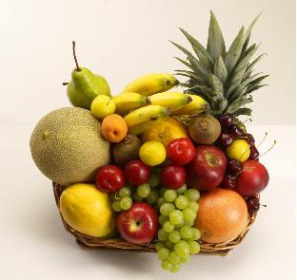
Chapter 4
Esters
Warm Up
Look at the picture given aside and guess what you are going to learn in this chapter.

Slide 4
Chapter 4
Introduction
The product of the reaction between a carboxylic acid and an alcohol is called an ester.
Esterification reaction is very similar to neutralization reaction.

Slide 5
Chapter 4
1. Esters
Esters are alkyl salts of carboxylic acids.
RCOOR is general formula of esters.
General representation is
Esters with low molecular weight are commonly used as fragrances found in essential oils.
The preparation of an ester is known generally as an esterification reaction.

Slide 6
Chapter 4
1. Esters
Example 1
What is the formula of an ester which has a molecular weight of 116 g? Assume that the alcohol and acid portions of the ester contain equal number of carbon atoms.
Solution
General formula of esters if the components of acid and alcohol contain equal number of carbon atom, is C_{n}H_{2n}O₂.

Slide 7
Chapter 4
2. Nomenclature of Esters
Alcohol group is named first, followed by the name of corresponding acid.
The “–ic acid” ending is changed to “–oate”.

Slide 8
Chapter 4
2. Nomenclature of Esters
Example 2
Name the following compounds
A.
B.
isobutyl acetate
propyl formate
C.
D.
cyclopentyl acetate
methyl benzoate

Slide 9
Chapter 4
2. Nomenclature of Esters
Example 3
Draw the structures of following esters.
n-pentyl acetate
propyl benzoate
isopropyl butanoate
cyclopropyl methanoate
Example 4
Find all possible isomers of C₄H₈O₂ and name them with
IUPAC system.

Slide 10
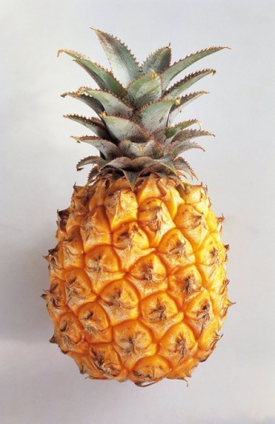
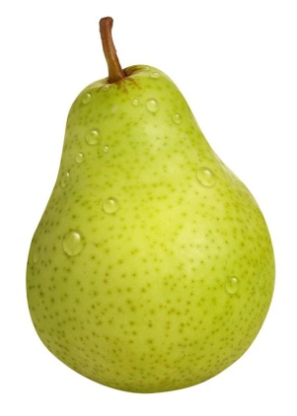

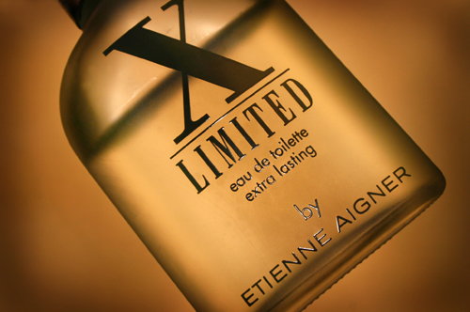
Chapter 4
3. Physical Properties of Esters
Low molecular weights have pleasant smelling.
They are obtained from flowers and fruits.
They are responsible for the flavor and fragrances of many fruits and flowers.
They are used as perfumes and artificial flavors in foods and drinks. For example, ethyl acetate gives apple flavor and propyl acetate smells like pears.

Slide 11
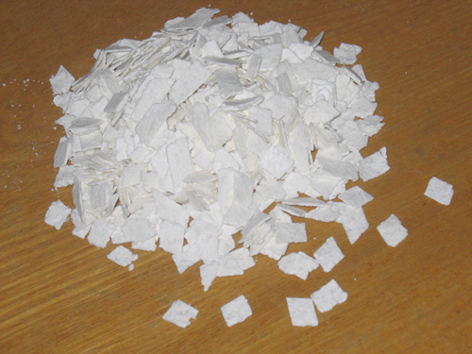
Chapter 4
3. Physical Properties of Esters
They cannot form hydrogen bond so they have low boiling
points.
They are soluble in water.
Liquid esters are good organic solvents, such as
nitrocellulose, it is used to dissolve resins and plastics.

Slide 12
Chapter 4
4. Chemical Properties of Esters
1. Hydrolysis of Esters

Slide 13
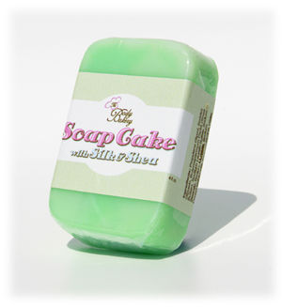
Chapter 4
4. Chemical Properties of Esters
2. Saponification of Esters
When esters are heated with aqueous solutions
of strong bases such as NaOH and KOH, salts of
carboxylic acids are produced, of which reaction is
called saponification.

Slide 14

Chapter 4
4. Chemical Properties of Esters
2. Saponification of Esters

Slide 15
Chapter 4
4. Chemical Properties of Esters
3. Reduction of Esters

Slide 16
Chapter 4
4. Chemical Properties of Esters
4. Reaction with Ammonia

Slide 17
Chapter 4
4. Chemical Properties of Esters
Example 5
What products would result from treating ethyl propanoate
with
H₂O B. NaOH C. NH₃
D. H₂ (in the presence of copper chromide catalyst)
Solution
A.

Slide 18
Chapter 4
4. Chemical Properties of Esters
Solution
B.
C.
D.

Slide 19
5. Preparation of Esters
Chapter 4
From Carboxylic Acid and Alcohols
Example 6
How many mL of 0.5 M acetic acid solution are required to
produce 17.6 g ethyl acetate?

Slide 20
5. Preparation of Esters
Chapter 4
From Carboxylic Acid and Alcohols
Solution

Slide 21
5. Preparation of Esters
Chapter 4
Example 7
Give the structure and name of the ester formed from
butyl alcohol and benzoic acid
benzyl alcohol and butyric acid
acetic acid and glycerol
formic acid and isopropanol

Slide 22
5. Preparation of Esters
Chapter 4
Example 8
Following substances are given;
ethanol, water, methyl butanoate, hydrogen
Write down the preparation reactions of following substances
by using one of the substances above.
Ethyl formate
Sodium butanoate
Isopropyl alcohol
Acetic acid

Slide 23
5. Preparation of Esters
Chapter 4
Example 9
C₃H₆O₂ is given as an ester molecule.
Write down a preparation reaction.
Write down two chemical properties of the molecule.
Write down two isomers of the molecule.

Slide 24
5. Preparation of Esters
Chapter 4
Example 10
For the analysis, a 26.4 g sample of an organic substance
when burnt, 21.6 g of water and a gas were obtained.
The gas then was passed through lime water solution and
120 g precipitate was obtained. If the relative density of this
substance with respect to helium gas is 22, what would be
the molecular formula of the substance?

Slide 25
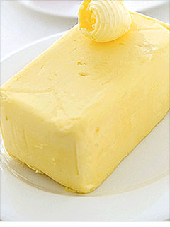
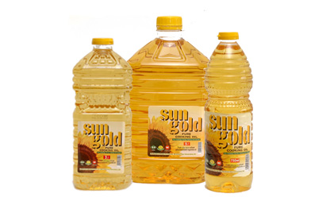
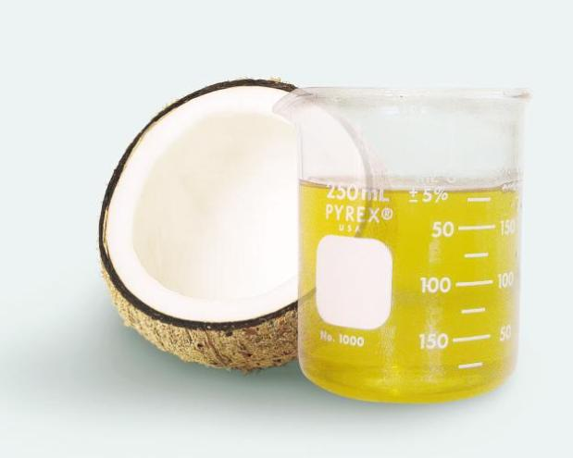
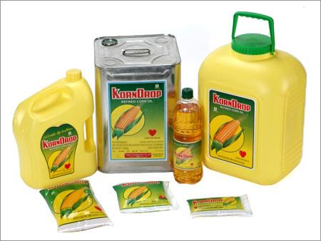
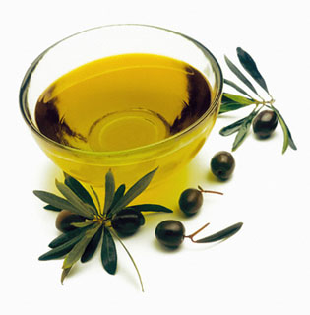
Chapter 4
6. Fats
Fats are esters of fatty acids and glycerine.
They are also known as triglycerides.

Slide 26
Chapter 4
6. Fats
Fats and oils, carbohydrates, and proteins are the three major kinds of foodstuff, but fats and oils provide the most calories per gram.
They have many uses in industry for the manufacture of soaps, synthetic detergents, glycerol, drying oils, oilcloth, paints, and varnishes.
Fats are solid esters of glycerol, and oils are liquid esters of glycerol (at room temperature).
If the R groups are saturated the glycerol esters are mostly solids. In contrast, oils contain many double bonds.

Slide 27
Chapter 4
6. Fats
If the acid parts of fat are all the same it is called simple glyceride. If they are different it is known as complex.
Pure fats contain around 95% triglycerides. The remaining are mono and diglycerides, glycerine, some free fatty acids, vitamins and minerals to give color and taste.
According to source there are animal fats extracted from suet and fish, and vegetable fats from olive, corn, cotton, sunflower, soybean, sesame, peanut, hazelnut, dates almonds, and coconuts.

Slide 28
Chapter 4
7. Hydrogenation and Margarines
Vegetable oils, which are highly unsaturated, can be converted into solid vegetable oils, called margarines, by catalytically hydrogenating some or all the double bonds. This process is called hardening. It is carried by passing hydrogen through them in the presence of Ni catalyst under pressure by heating.

Slide 29
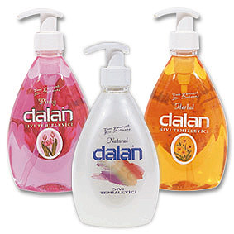
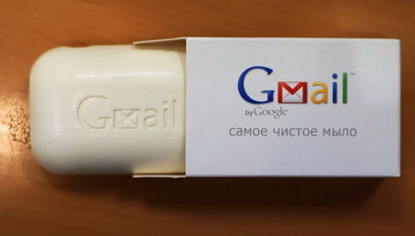
Chapter 4
8. Saponification
Hydrolysis of glycerides in basic medium leads glycerol and a mixture of salts of long chained carboxylic acids. This mixture is soap and the process is called saponification.
The most widely used ordinary soaps are sodium soaps. Potassium soaps form soaps which are softer and more soluble. Aluminum soaps are gels which can be used as thickeners for lubricating greases.

Slide 30
Chapter 4
9. Cleaning Process of Soaps
In the soap molecule, one end is highly polar or ionic, whereas the other end is highly non polar. The ionic end has a great tendency to dissolve in water. It is hydrophilic (water loving). The carbon chain tends to be very insoluble in water but soluble in fats and oils. It is hydrophobic (water hating).

Slide 31
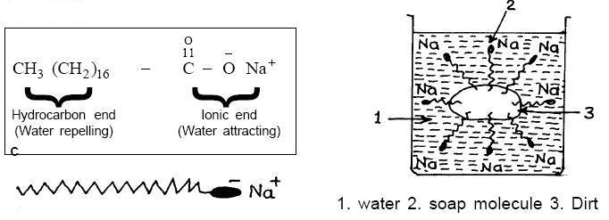
Chapter 4
9. Cleaning Process of Soaps
Soap micelles absorb grease molecules into their interiors so that the grease is suspended in the water and can be washed away.

Slide 32

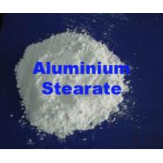
Chapter 4
9. Cleaning Process of Soaps
The Ca⁺² and Mg⁺² salts of fatty acids are insoluble in water, they are called marble salts.
Magnesium oleate is insoluble in water and soluble in organic solvents, hence it can be used for dry cleaning.
Lead stearate is used in the production of salve.
Aluminum stearate is used in the production of water resistant clothes.
Lead
stearate.

Slide 33
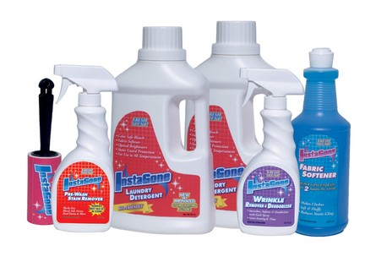
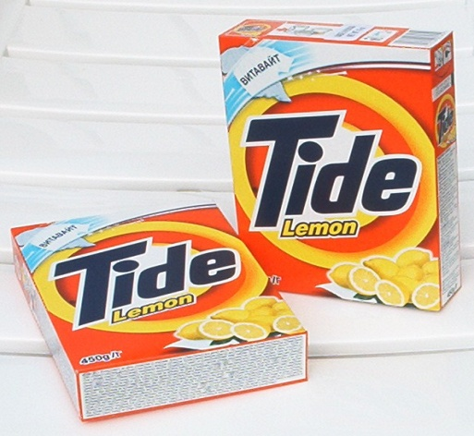
Chapter 4
10. Detergents
Detergents are artificial soaps.
The most common detergent is alkyl benzene sulfanates (ABS) and alky sulfates (AS).
Synthetic detergents are more active cleaners than soaps. They do not precipitate with Ca⁺² and Mg⁺² ions in hard water.
The do not have basic character like soaps.

Slide 34
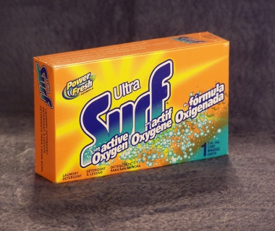
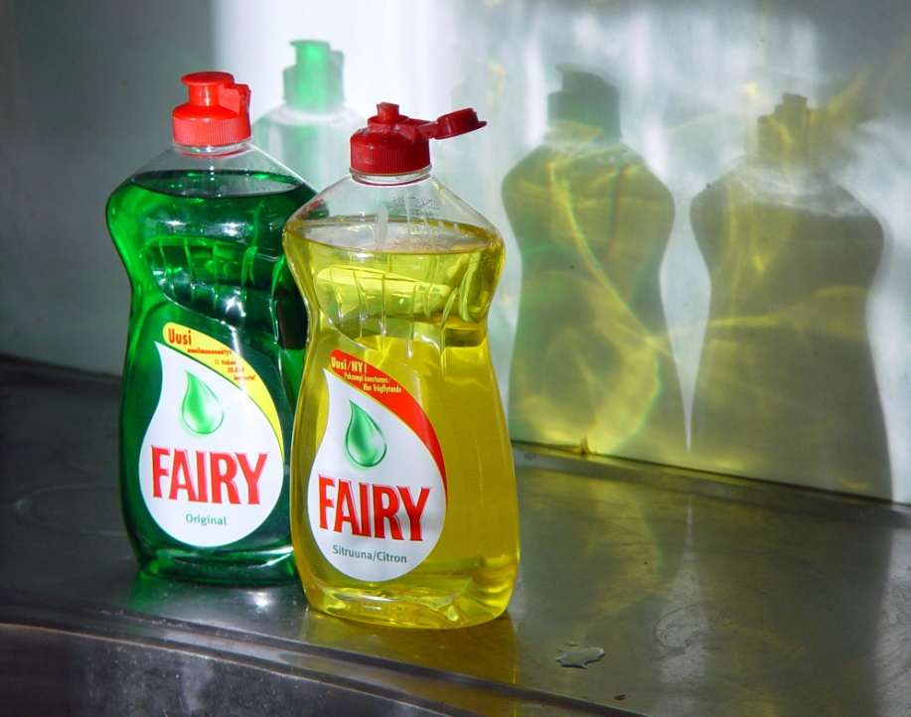
Chapter 4
10. Detergents

Slide 35
End of the chapter 4

