Slide 1
Chapter 7
Ion Analysis
Table of Contents
Analysis of Cations
Analysis of Anions

Slide 2
Chapter 7
Ion Analysis
Warm up
List down some types of reactions.
Evidences of indications that proves reactions.
Explain precipitation, how do ions make precipitation?

Slide 3
Chapter 7
Ion Analysis
Qualitative Analysis is the determination of non-numerical information about a chemical species.
Examples would be observing that a reaction is creating a gas that is bubbling out of solution, observing that a reaction results in a color change or producing a precipitate.
CaCO₃ + 2HCI → CaCl₂ + CO₂↑ + H₂O
AgNO₃(aq) + NaCl(aq) → AgCl(s) ↓ + NaNO₃(aq)
FeCl₃(aq) + 3KSCN(aq) → Fe(SCN)₃(red) + 3KCl(aq)

Slide 4
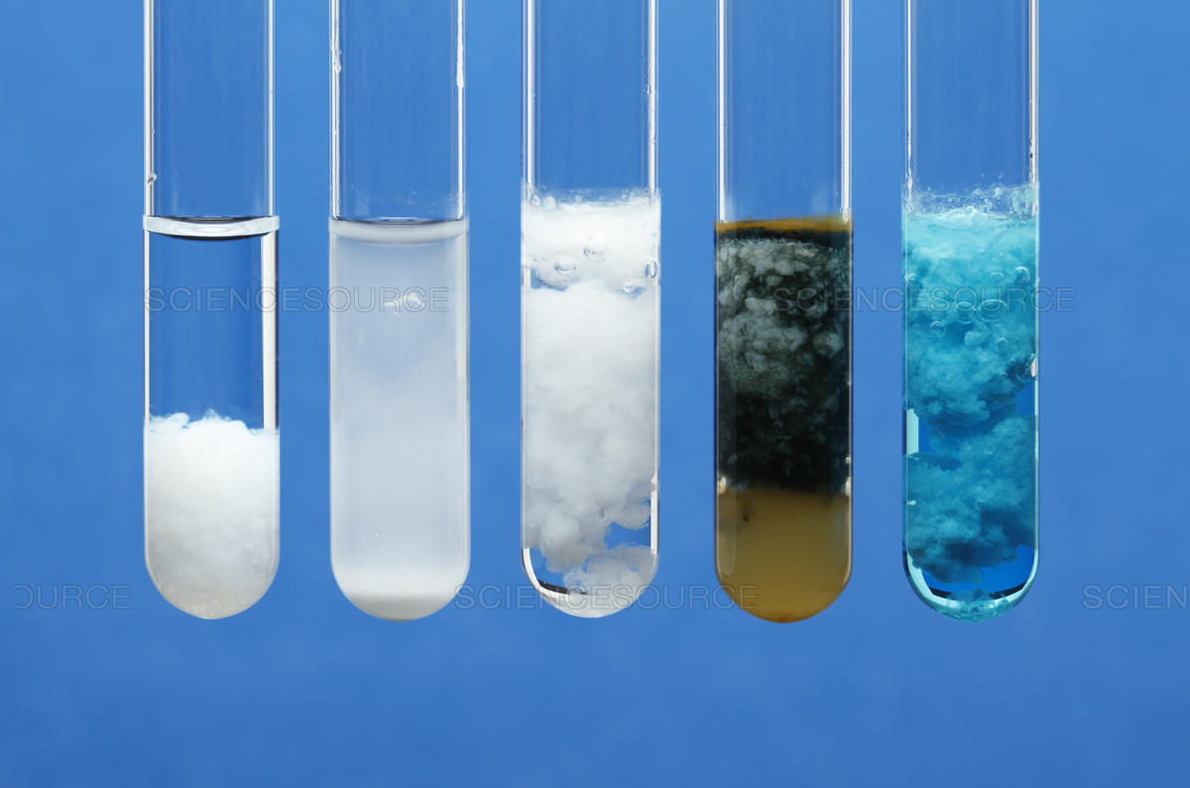
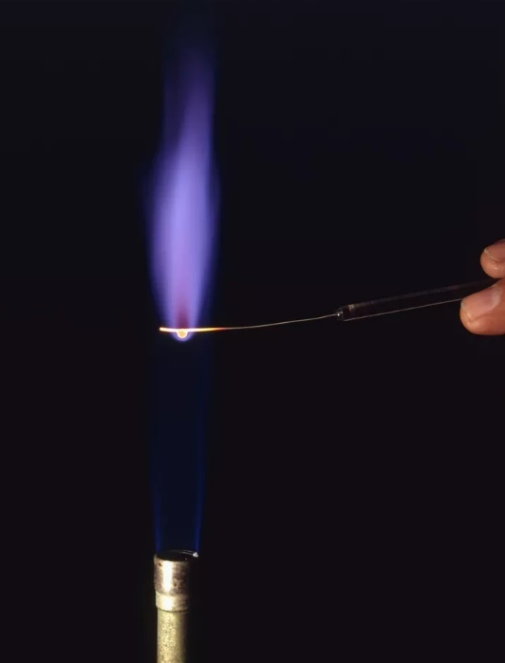
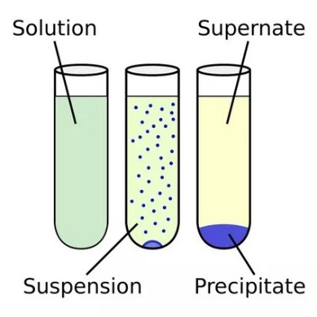
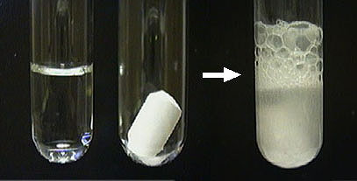
Chapter 7
Ion Analysis

Slide 5
Chapter 7
Ion Analysis
Example 1
Complete the following reactions.
A. LiOH(aq) + MgCl₂(aq) →
B. K₂CO₃(aq) + HCl(aq) →
C. NH₄I (aq) + Ba(OH) ₂(aq) →
D. H₂S(g) + AgNO₃(aq) →
E. CuSO₄ + Na₃PO₄ →

Slide 6
Chapter 7
1. Analysis of Cations
There are 6 groups of cations.
Grp | Cations | Reagents | Characteristics of the group
1 | Pb²⁺ Ag¹⁺ Hg₂²⁺ | HCl 2mol/L | Chlorides are insoluble in water, cations are colorless. PbCl₂ is little soluble in cold water, AgCl is soluble in concentrated ammonia.
2 | Ca²⁺ Ba²⁺ Sr²⁺ | H₂SO₄ 2mol/L | Sulfates are insoluble in water and dilute acid solutions (CaSO₄ is little soluble), BaSO₄ is insoluble in concentrated acid solutions, cations are colorless,
3 | Al³⁺ Zn²⁺ Cr³⁺ | NaOH 2mol/L | Hydroxides are amphoteric, insoluble in water, soluble in alkaline base solutions, and in acids. Al³⁺ and Zn²⁺ are colorless, Cr³⁺ is green or violet

Slide 7
Chapter 7
1. Analysis of Cations
There are 6 groups of cations.
Grp | Cations | Reagents | Characteristics of the group
4 | Fe³⁺ Mg²⁺ Fe²⁺ Mn²⁺ | NH₄OH NaOH 2mol/L | Hydroxides are insoluble in water, ammonia and alkaline bases, soluble in acids. Mg²⁺ and Mn²⁺ are colorless, Fe²⁺ is greenish, Fe³⁺ is yellow
5 | Cu²⁺ Co²⁺ Ni²⁺ Hg²⁺ | NH₄OH conc. | Hydroxides are insoluble in water and bases, but soluble in ammonia and acids. Mn²⁺ is blue, Co²⁺ is pink, Ni²⁺ is green
6 | NH₄¹⁺ Na¹⁺ K¹⁺ |  | All hydroxides and salts are soluble in water, cations are colorless.

Slide 8
Chapter 7
1. Analysis of Cations
Identification of cations
Ion | Reagent | Analytical Signal | Properties
Pb²⁺ | HCl | ↓ white | Soluble in hot water
Pb²⁺ | KI | ↓ yellow | Soluble in hot water
Ba²⁺ | H₂SO₄ | ↓ white crystal | Insoluble in HNO₃
Ca²⁺ | H₂SO₄ | ↓ white crystal | Soluble in HNO₃
Ca²⁺ | H₂C₂O₄ | ↓ white | Soluble in mineral acids
Fe³⁺ | NaOH | ↓ brown | Soluble in mineral acids
Fe³⁺ | KSCN | Red solution
NH₄¹⁺ | NaOH, ºt | ↑ sharp smell | Phenolphthalein -raspberry
Solubility Chart

Slide 9
Chapter 7
1. Analysis of Cations
Example 2
At a chemistry practical test-paper one student realized two analytical reactions, having the following substances at his disposal:
Fe₂(SO₄)₃, НCl, KOH, AgNO₃, (NH₄)₂СО₃.
In each case the analytical signal was different.
For each case, choose one pair of substances from the list above and write an equation of the identifying reactions of cations in molecular, complete ionic, and net ionic equation form.
A.
………………………….……………………………………ME
…………….…………………..……………………………CIE
………………………………………………………………NIE
Analytical signal.………………………………….

Slide 10
Chapter 7
1. Analysis of Cations
Example 3
In a food certification laboratory, several preliminary investigations have been carried out on the composition of additives used by a private enterprise.
1. Each of the additives to be analyzed in column A, reagents used in column B and analytical signal in column C. Match for each additives with A and B.
A B C
Additives analyzed Reagents used Analytical signal
a. sodium sulfate …………..1. barium chloride …….………………….
b. calcium nitrate …………..2. hydrochloric acid ……………………….
c. ammonium nitrate …………..3. sodium hydroxide ………...……………..
d. sodium carbonate ………………………..
2. Using one of the identifying reaction of a cation, write the equation in molecular, complete ionic, and net ionic form.

Slide 11
Chapter 7
1. Analysis of Anions
There are 3 groups of anions.
Grp | Anion | Reagents | Characteristics of the group
1 | SO₄⁻², PO₄⁻³ , CO₃⁻² , SO₃⁻² , SiO₃⁻² | BaCl₂ 2 mol/L, in neutral medium or weak base | Salts of Ba are soluble in acids, except BaSO₄, colorless anions.
2 | Cl⁻, Br⁻, I⁻, S²⁻ | AgNO₃ 0.1 mol/L, in HNO₃ | Salts of Ag are insoluble in water, anions are colorless, I⁻ is yellowish.
3 | NO₃⁻¹, CH₃COO¹⁻ |  | All salts are soluble in water, Anions are colorless.

Slide 12
Chapter 7
1. Analysis of Anions
Identification of with common reagents
Reagent | SO₄⁻² | CO₃⁻² | Cl⁻
BaCl₂ | ↓ white, insoluble in HNO₃ | ↓ white, soluble in HNO₃, CO₂ gas formation
AgNO₃ | ↓ white, soluble in HNO₃ | ↓ white, soluble in HNO₃, CO₂ gas formation | ↓ cheese white, insoluble in HNO₃, darken in light

Slide 13
Chapter 7
1. Analysis of Anions
Identification reactions of anions
Ion | Reagent | Analytical Signal | Properties
SO₄⁻² | Ba²⁺ | ↓ white crystal | Insoluble in HNO₃
SO₄⁻² | Ca²⁺ | ↓ white crystal | soluble in HNO₃
CO₃⁻² | Ba²⁺ | ↓ white crystal | Insoluble mineral acids ↑
CO₃⁻² | H⁺ | ↓ colorless | CO₂, turbidity, lime water
Cl⁻ | Ag⁺ | ↓ white cheese | Insoluble in HNO₃, soluble in NH₄OH

Slide 14
Chapter 7
1. Analysis of Anions
Example 4
In a waste water treatment facility following ions are tested:
NH₄⁺, Na⁺, Cl⁻, CO₃²⁻, SO₄²⁻.
As a result of the analysis, the maximum admissible limits for three of the investigated ions were exceeded.
A. Complete the table with possible results in the analysis:
Ions found | Chemical formula of the reagent to be used | Analytical signal
NH₄⁺ | ………………………….... | ……………………....
…………………….... | HNO₃ | ……………………....
…………………….... | ………………………….... | White precipitate
B. For the substances, according to the table, write an equation of the identifying reaction for an anion in molecular, complete ionic, and net ionic equation.

Slide 15
End of the chapter 7

