Slide 1
Chapter 2
Rate of Reactions
Table of Contents
Meaning and Measurement of Rate of Reactions
Collision Theory
Rate Expression and Rate Constant
Factors Affecting Rate

Slide 2
Chapter 2
Rate of Reactions
Warm up
List down some moving objects with their average speeds.
Explain how you know their speeds.
Try to explain some chemical changes with their rates.

Slide 3
Chapter 2
1. Meaning and Measurement of Rate
Rate is defined as the change in concentration of products or reactants in a course of time.
Reaction rate is the maximum at the beginning of reaction.
The reaction rate decreases as the concentration of
reactants decrease.
The study of reaction rates and reaction mechanisms is chemical kinetics.

Slide 4
Chapter 2
1. Meaning and Measurement of Rate

Slide 5
Chapter 2
1. Meaning and Measurement of Rate
Lets have closer look to the reaction below.
Concentration, M
Concentration, M
Products NO or CO₂
.
Slope = tgα =Rate
Reactants CO or NO₂
α
Time
Time

Slide 6
Chapter 2
1. Meaning and Measurement of Rate

Slide 7
Chapter 2
1. Meaning and Measurement of Rate
Example 1
Find the rate relationship of reactants and products for the given reaction.
N₂(g) + 3H₂(g) → 2NH₃(g)
Solution

Slide 8
Chapter 2
1. Meaning and Measurement of Rate
Example 2
In the following decomposition reaction,
2N₂O₅ → 4NO₂ + O₂
oxygen gas is produced at the average rate of 9.1 × 10⁻⁴ mol · L⁻¹· s⁻¹. Over the same period, what is the average rate of the following:
the production of nitrogen dioxide.
the loss of dinitrogen pentoxide.

Slide 9
Chapter 2
1. Meaning and Measurement of Rate
Solution
rate NO₂ production = 4 × (9.1 × 10⁻⁴ mol · L⁻¹· s⁻¹)
= 3.6 × 10⁻³ mol · L⁻¹· s⁻¹
rate loss of N₂O₅ = 2× (9.1 × 10⁻⁴ mol · L⁻¹· s⁻¹)
= 1.8 × 10⁻³ mol · L⁻¹· s⁻¹

Slide 10
Chapter 2
1. Meaning and Measurement of Rate
Example 3
Consider the following reaction:
N_{2(g)} + 3H_{2(g)} → 2NH_{3(g)}
If the rate of loss of hydrogen gas is 0.03 mol · L⁻¹· s⁻¹, what is the rate of production of ammonia?
Solution
From the balanced equation we see that there are 2 moles NH₃ produced for every 3 moles H₂ used. Thus:
rate NH₃ production =2/3 × (0.03 mol · L⁻¹· s⁻¹)
= 0.02 mol · L⁻¹· s⁻¹

Slide 11
Chapter 2
1. Meaning and Measurement of Rate
Example 4
0.05 mol of SO₃ gas is produced in 1-L container within 2 minutes according to the reaction below. Find the rate of consumption of SO₂ and O₂ gases in M/s.
2SO₂(g) + O₂(g) → 2SO₃(g)
Example 5
The rate of the reaction according to Mg is 0.6 g/s. What is the pressure of H₂ gas produced at STP after 5 min in 1-L container?
Mg(s) + 2H₂O(g) → Mg(OH)₂(aq) + H₂(g)

Slide 12
Chapter 2
2. Collision Theory
Collision theory explains the chemical reactions occur as a result of collisions. For a collision to lead to a reaction;
Molecules must be properly oriented,
Molecules must have enough energy.
Arrhenius proposed that for colliding molecules to lead to a reaction they must be “activated”.
The minimum energy which reacting molecules must have for resulting in a reaction is called “activation energy”, Ea. The molecules which have activation energy can form “activated complex” or “transition state”.

Slide 13
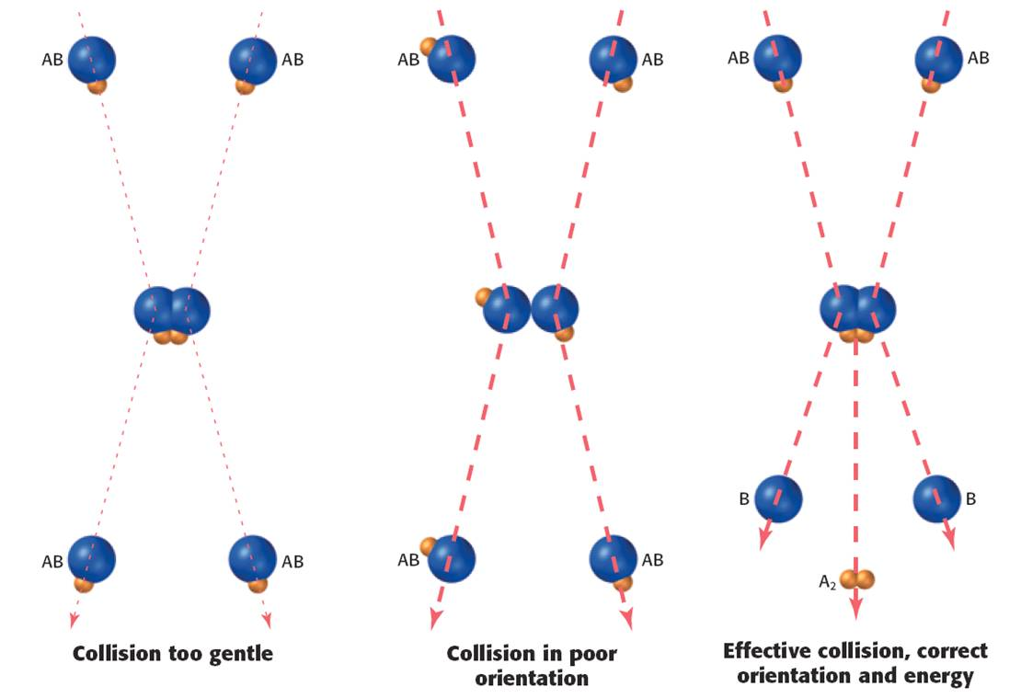
Chapter 2
2. Collision Theory

Slide 14
Chapter 2
2. Collision Theory

Slide 15
Chapter 2
2. Collision Theory

Slide 16
Chapter 2
2. Collision Theory

Slide 17
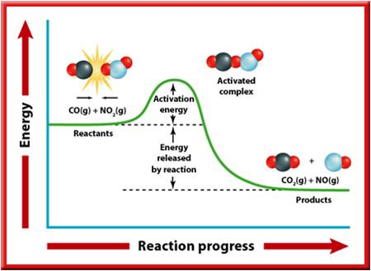
Chapter 2
2. Collision Theory
∆H
PE-RC Diagram for an exothermic reaction

Slide 18
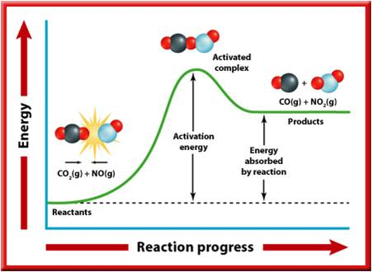
Chapter 2
2. Collision Theory
∆H
PE-RC Diagram for an endothermic reaction

Slide 19
Chapter 2
2. Collision Theory
The heat of reaction, ∆H, in terms of activation energies is defined as follows;
∆H = Ea_{f} - Ea_{r}
Example 6
If the PE-RC diagram for C + O₂ → CO₂ given below;
calculate, ∆H, Ea_{f}, and Ea_{r}
PE
242
0
C + O₂
-393
CO₂
RC

Slide 20
Chapter 2
2. Collision Theory
Solution
PE
242
∆H = Ea_{f} – Ea_{r}
= 242- (393 + 242)
= - 393 kj
Ea_{f}
C + O₂
Ea_{r}
0
∆H
CO₂
-393
RC

Slide 21
Chapter 2
2. Collision Theory
Example 7
Following PE-RC diagram for the reaction
A₂ + B₂ → 2AB given below;
calculate, ∆H, Ea_{f}, and Ea_{r}
PE
80
55
2AB
A₂ + B₂
45
0
RC

Slide 22
Chapter 2
2. Collision Theory
Solution
PE
80
∆H = Ea_{f} - Ea_{r} = 35 – 25 = 10 kj
Ea_{f}
Ea_{r}
55
2AB
∆H
A₂ + B₂
45
0
RC

Slide 23
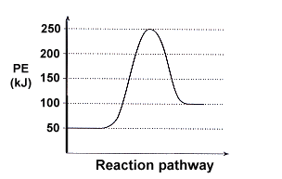
Chapter 2
2. Collision Theory
Example 8
Answer the following questions based on the potential energy diagram shown here:
Does the graph represent an
endothermic or exothermic reaction?
Label the position of the reactants,
products, and activated complex.
Determine the heat of reaction,
ΔH, (enthalpy change) for this reaction.
Determine the activation energy,
Ea for this reaction.
How much energy is released or absorbed during the reaction?
How much energy is required for this reaction to occur?

Slide 24
Chapter 2
2. Collision Theory
Example 9
Sketch a potential energy curve that is represented by the following values of ΔH and E_{a}. You may make up appropriate values for the y-axis (potential energy).
ΔH = -100 kJ and E_{a} = 20 kJ
Is this an endothermic or exothermic reaction?

Slide 25
3. Rate Expression and Rate Constant
Chapter 2
Consider the one step following reaction;
mA + nB → products
The rate expression is proportional to the product of [A] (to some power m) and [B] (to some power n). To create an equation instead of a proportion, use the rate constant k.
Rate = k[A]^{m}[B]^{n}
m and n are order of reaction with respect to related substance, and k depends only on temperature and activation energy.
Solids and liquids are not included in the expression, only gaseous and aqueous ions are indicated in the rate expression.

Slide 26
3. Rate Expression and Rate Constant
Chapter 2
Example 10
Write the possible rate expression of the following reactions.
Cl₂(g) + H₂(g) → 2HCl(g)
2Fe(s) + 3Cl₂(g) → 2FeCl₃(g)
Fe₂O₃ (s) + 3H₂SO₄ (aq) → Fe₂(SO₄)₃ (s) + 3H₂O(l)
Ca(s) + 2Ag⁺(aq) → Ca⁺² (aq) + 2Ag(s)
Solution
Rate = k[H₂SO₄]³
Rate = k[Ag⁺]²
Rate = k[Cl₂][H₂]
Rate = k[Cl₂]³

Slide 27
3. Rate Expression and Rate Constant
Chapter 2
Example 11
Write the rate expression of the following one step reaction, determine the order of reaction in terms of N₂ and H₂, and overall order.
N₂(g) + 3H₂(g) → 2NH₃(g)
Solution
Rate = k[N₂][H₂]³
Order in terms of N₂ is 1 and 3 in terms of H₂
Overall order is 1+3 = 4

Slide 28
3. Rate Expression and Rate Constant
Chapter 2
Reaction Mechanism
A mechanism for a reaction is a collection of elementary processes (also called elementary steps or elementary reactions) that explains how the overall reaction proceeds.
For the reaction
H₂ + Br₂ → 2 HBr
Following mechanism has been proposed,
1.step Br₂ → 2Br (fast)
2.step Br + H₂ → HBr + H (slow)
3.step H + Br₂ → 2HBr + Br (fast)

Slide 29
3. Rate Expression and Rate Constant
Chapter 2
The substances that appear in elementary steps but not in overall reaction are called reaction intermediate.
The slowest step in a mechanism is the rate-determining step.
The slowest step in a mechanism has the highest activation energy value.
In the example;
Br and H are reaction intermediates.
Rate determining step is 2nd step.
Therefore the rate expression is
Rate = k[ Br][H₂]

Slide 30
3. Rate Expression and Rate Constant
Chapter 2
Reaction Mechanism

Slide 31
3. Rate Expression and Rate Constant
Chapter 2
Reaction Mechanism

Slide 32
3. Rate Expression and Rate Constant
Chapter 2
Example 12
Find the rate expression of the following reaction;
NH₄⁺ + HNO₂ → N₂ + 2 H₂O + H⁺
having following mechanism;
1.Step HNO₂ + H⁺ → H₂O + NO⁺ (fast)
2.Step NH₄⁺ → NH₃ + H⁺ (fast)
3.Step NO⁺ + NH₃ → NH₃NO⁺ (slow)
4. Step NH₃NO⁺ → H₂O + H⁺ + N₂ (fast)
Rate = k [NH₃] [NO⁺]

Slide 33
3. Rate Expression and Rate Constant
Chapter 2
Example 13
PE
For a reaction PE-RC diagram
is given.
How many elementary
steps are there in the reaction?
Show the activation
energies of all steps.
Which step is the slowest, and rate determining step?
Is the reaction exothermic or endothermic?
RC

Slide 34
3. Rate Expression and Rate Constant
Chapter 2
Solution
PE
Ea₃
Ea₁
Ea₂
∆H
RC

Slide 35
3. Rate Expression and Rate Constant
Chapter 2
Example 14
Which of the following reactions would you expect to have the highest quantity of activation energy?
A. H_{2(g)} + 1/2O_{2(g)} → H₂O_{(g)}
B. H₂SO_{4(l)} →H⁺_{(aq)} + HSO₄⁻_{(aq)}
C. Ag⁺_{(aq)} + Cl⁻_{(aq)} → AgCl_{(s)}
D. CH_{4(g)} + 2O_{2(g)} → CO_{2(g)} + 9H₂O_{(g)}
E. C₈H_{18(g)} + 25/2O_{2(g)} → 8CO_{2(g)} + 9H₂O_{(g)}

Slide 36
3. Rate Expression and Rate Constant
Chapter 2
Example 14
Which of the following reactions would you expect to have the highest quantity of activation energy?
A. H_{2(g)} + 1/2O_{2(g)} → H₂O_{(g)}
B. H₂SO_{4(l)} →H⁺_{(aq)} + HSO₄⁻_{(aq)}
C. Ag⁺_{(aq)} + Cl⁻_{(aq)} → AgCl_{(s)}
D. CH_{4(g)} + 2O_{2(g)} → CO_{2(g)} + 9H₂O_{(g)}
E. C₈H_{18(g)} + 25/2O_{2(g)} → 8CO_{2(g)} + 9H₂O_{(g)}

Slide 37
Chapter 2
4. Factors Affecting Rate

Slide 38
Chapter 2
4. Factors Affecting Rate
A. Nature of Reactants
Generally;
If there are many bonds must be broken and many bonds must be formed in a reaction then the reaction is slow.
The reactions between simple ions are very fast.
If the reaction is between many ions and molecules then the reaction is slow.
C₃H₆O + 4O₂ → 3CO₂ + 3H₂O (Slow)
Ag⁺(aq) + Cl⁻(aq) → AgCl(s) (very fast)
2MnO₄⁻(aq) + 5SO₃⁻²(aq) + 6H⁺ → 2Mn⁺²(aq) + 5SO₄⁻²(aq) + 3H₂O (fast)

Slide 39
Chapter 2
4. Factors Affecting Rate
B. Concentration of Reactants
Rate of reactions increases when the concentration of reactant is increased. Rate of reactions is directly proportional to the concentration of reactants.
Example 15
For the reaction, 2X_{(g)}+3Y_{(g)}+Z_{(g)}→2K_{(g)}+L_{(g)}
the reaction rate increases by a factor of 8 when the volume of the container is halved. Doubling only the concentration of X increases the rate by a factor of 2 and doubling only the concentration of Z has no influence on the reaction rate. Using these data, determine the rate law for the reaction.
Solution rate= k[X][Y]²

Slide 40
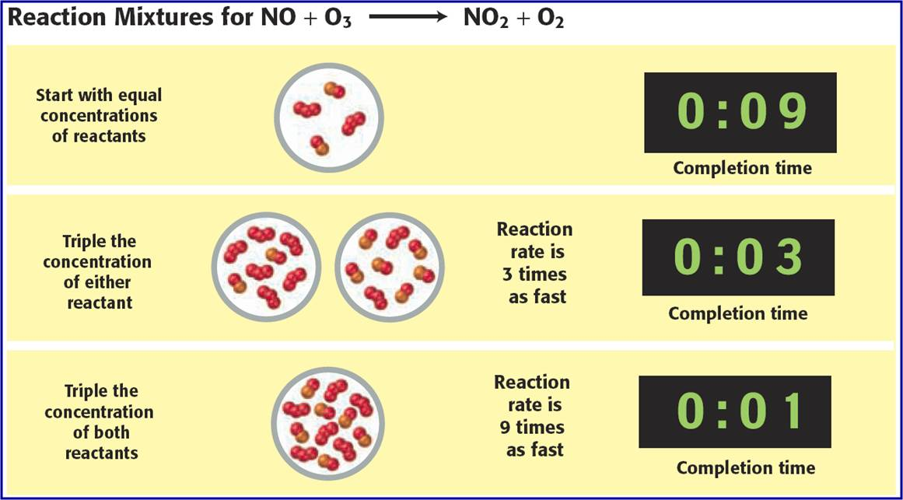
Chapter 2
4. Factors Affecting Rate
B. Concentration of Reactants

Slide 41
Chapter 2
4. Factors Affecting Rate
B. Concentration of Reactants
Example 16
The following data were recorded to determine the rate equation of the reaction; O_{3(g)}+NO_{(g)}→O_{2(g)}+NO_{2(g)}
I. When the concentrations of both O₃ and NO were doubled, the rate increased 4 times.
II. When the concentration of NO was held constant but the concentration of O₃ was tripled, the rate was tripled too.
A. Find the rate equation for the reaction.
B. If both [O₃] and [NO] had tripled what would have been the rate?
Solution
A. Rate=k[NO][O₃], B. Rate would have increased 9 times.

Slide 42
Chapter 2
4. Factors Affecting Rate
B. Concentration of Reactants
Example 17
The following data were collected for the reaction,
2X_{(g)} + 3Y_{(g)} + Z_{(g)} → 2K_{(g)} + L_{(g)}
Find the rate expression and the value of k.
Exp No [X] M [Y] M [Z] M Initial Rate (M/min)
1 0.2 0.1 0.1 4.0x10⁻³
2 0.2 0.2 0.1 16x10⁻³
3 0.2 0.2 0.2 16x10⁻³
4 0.1 0.2 0.1 8.0x10⁻³
Solution
Rate =k[X][Y]², k = 2 M⁻²min⁻²

Slide 43
Chapter 2
4. Factors Affecting Rate
B. Concentration of Reactants
Example 18
The following data are given for the reaction: 2A+B+C → D+2E
Find the rate expression, order and the value of rate constant, k.
[A]M [B]M [C]M Initial rate (M/min)
0.1 0.2 0.2 4.0x10⁻³
0.1 0.4 0.2 4.0x10⁻³
0.2 0.2 0.2 8.0x10⁻³
0.3 0.1 0.2 1.2x10⁻²
0.1 0.4 0.6 1.2x10⁻²
Solution
Rate =k[A][C], overall order is 1+1=2, k = 0.2 M⁻¹min⁻¹

Slide 44
Chapter 2
4. Factors Affecting Rate
C. Temperature of the System
Rates of almost all reactions increase as temperature is increased. It is often stated that rate doubles by increasing 10ºC.
In 1889, Svante Arrhenius stated that rate constant changes by modifying the temperature.
k = A.e^{-Ea/RT}
Where k is rate constant, A is Arrhenius constant, Ea is activation energy, R is gas constant, T is Kelvin temperature.
The equation can also be written;
ln k = lnA – Ea or log k =log A – Ea
RT 2.303RT

Slide 45
Chapter 2
4. Factors Affecting Rate
C. Temperature of the System
No of Molecules
The major factor in increasing rate when temperature is increased is increasing effective collisions.
TºC
(T+20)ºC
b
a
Ea
Kinetic Energy
At TºC number of molecules exceeding Ea is a,
At (T+20) ºC number of molecules exceeding Ea is a+b.

Slide 46
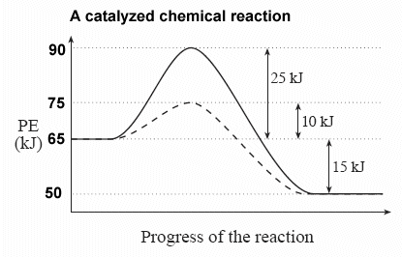
Chapter 2
4. Factors Affecting Rate
D. Presence of a Catalyst
A catalyst is a substance which increases rate of reaction without being consumed in reactions.
It provides an alternate reaction pathway with a lower activation energy.

Slide 47
Chapter 2
4. Factors Affecting Rate
D. Presence of a Catalyst

Slide 48
Chapter 2
4. Factors Affecting Rate
D. Presence of a Catalyst
Catalyst have the following properties;
They remain unchanged after the reaction,
Both reverse and forward reactions are affected by catalyst,
∆H remains unchanged,
It does not make impossible reactions possible.
Example 19
Depletion of ozone layer is speeded up by CFC gases in which Cl∙ radicals acts as catalyst.
O₃(g) + Cl∙(g) → O₂(g) + ClO∙(g)
ClO∙(g) + O∙(g) → O₂(g) + Cl∙(g)

Slide 49
Chapter 2
4. Factors Affecting Rate
D. Presence of a Catalyst

Slide 50
Chapter 2
4. Factors Affecting Rate
E. Interacting Area
Increasing surface area between colliding particles increases the rate of reactions.
Remember the dissolution of powdered sugar and lump of sugar.
For the reaction;
2HCl(aq) + CaCO₃(s) → CaCl₂(aq) + CO₂(g) + H₂O(g)
If powdered CaCO₃ is used the reaction will be faster

Slide 51
End of the chapter 2

