Slide 1
Chapter 4
Solubility Equilibrium
Table of Contents
Solubility Product
Factors Affecting Solubility
Selective Precipitation
Qualitative Analysis of Cations

Slide 2
Chapter 4
Solubility Equilibrium
Warm up
Give some examples about soluble substances in water.
How do you describe solubility of substances in water?
What are the factors affecting solubility?

Slide 3
Chapter 4
Solubility Equilibrium
Introduction
Solubility equilibrium is the equilibrium between a salt and its ions in a saturated solution.
CaSO₄(s) ⇔ Ca⁺²(aq) + SO₄⁻²(aq)

Slide 4
Chapter 4
1. Solubility Product
Since the dissolution of slightly soluble salts in water is an equilibrium, the equilibrium constant expression is called solubility product constant, Ksp.
PbCl₂(s) ⇔ Pb⁺²(aq) + 2Cl⁻(aq)
For the reaction,
Ksp = [Pb⁺²] [Cl⁻]²
Example 1
CuOH(s) ⇔ Cu⁺¹(aq) + OH⁻(aq) Ksp = [Cu⁺¹] [OH⁻]
Fe(OH)₃(s) ⇔ Fe⁺³(aq) + 3OH⁻(aq) Ksp = [Fe⁺³] [OH⁻]³

Slide 5
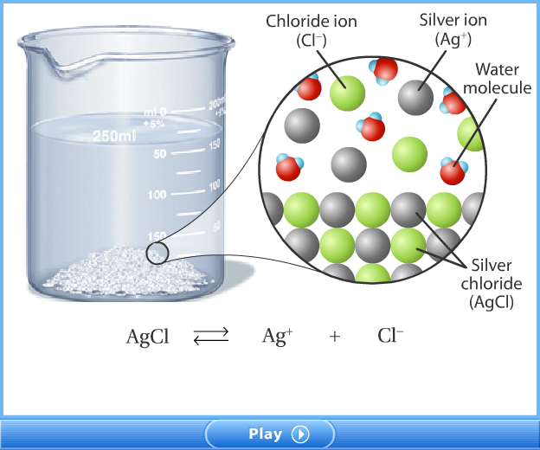
Chapter 4
1. Solubility Product

Slide 6
Chapter 4
1. Solubility Product
Relationship Between Solubility and Solubility Product
In one liter saturated solution the number of mole of dissolved salt is called molar solubility, shown by “s”.
Solubility product constant, Ksp, can be easily calculated by knowing molar solubility. For example, molar solubility of CaSO₄ is 1.5x10⁻² M, meaning concentration of each ion Ca⁺² and SO₄⁻² is 1.5x10⁻² M.
CaSO₄(s) ⇔ Ca⁺²(aq) + SO₄⁻²(aq)
change: -s +s +s
-1.5x10⁻² M +1.5x10⁻² M +1.5x10⁻² M
Ksp = [Ca⁺²] [SO₄⁻²] = s.s = s² = (1.5x10⁻²)² = 2.25x10⁻⁴.

Slide 7
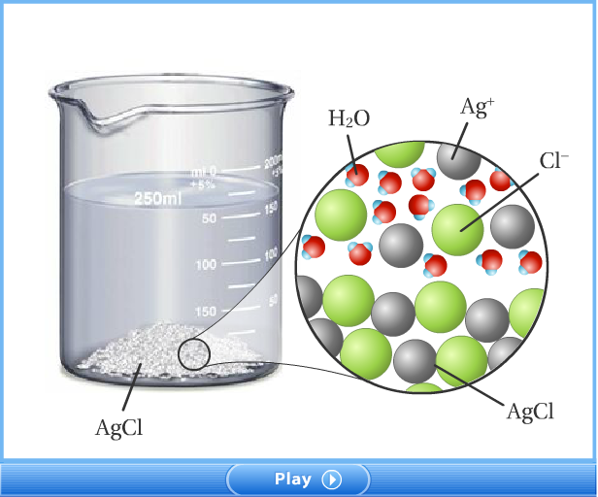
Chapter 4
1. Solubility Product
Relationship Between Solubility and Solubility Product

Slide 8
Chapter 4
1. Solubility Product
Relationship Between Solubility and Solubility Product
Example 2
If the solubility of CaF₂ is 2.0x10⁻⁴ M at 25ºC, what is the
solubility product constant of CaF₂?
Solution
CaF₂(s) ⇔ Ca⁺²(aq) + 2F⁻¹(aq)
change: -s +s +2s
-2x10⁻⁴ M +2x10⁻⁴ M +4x10⁻⁴ M
Ksp = [Ca⁺²] [F⁻¹]² = s.(2s)² = 4s³ = 4(2x10⁻⁴)³ = 3.2x10⁻¹¹.

Slide 9
Chapter 4
1. Solubility Product
Relationship Between Solubility and Solubility Product
For the same types of salts, the salt with the greater Ksp
value will be more soluble.
Example 3
Compare the molar solubilities of AgCl and AgBr, if they have
1.6x10⁻¹⁰ and 5.0x10⁻¹³ Ksp values respectively.
Solution
AgCl(s) ⇔ Ag⁺¹(aq) + Cl⁻¹(aq)
change: -s +s +s
Ksp = 1.6x10⁻¹⁰ = [Ag⁺] [Cl⁻¹] = s.s = s² ⇒ s=1.26x10⁻⁵ M

Slide 10
Chapter 4
1. Solubility Product
Relationship Between Solubility and Solubility Product
Solution
AgBr(s) ⇔ Ag⁺¹(aq) + Br⁻¹(aq)
change: -s +s +s
Ksp = 5.0x10⁻¹³ = [Ag⁺] [Br⁻¹] = s.s = s² ⇒ s=7.07x10⁻⁷ M
The solubility of AgCl is greater than that of AgBr.
Example 4
A 2.5 L saturated solution of Fe(OH)₂ at 25ºC contains 2.92 mg
of Fe(OH)₂. Calculate the Ksp value of Fe(OH)₂. (Fe(OH)₂ = 90)

Slide 11
Chapter 4
1. Solubility Product
Relationship Between Solubility and Solubility Product
Solution
n = 2.92x10⁻³/90 = 0.0324x10⁻³ mol
[Fe(OH)₂] = 0.0324x10⁻³/2.5 = 0.013x10⁻³M
Fe(OH)₂(s) ⇔ Fe⁺²(aq) + 2OH⁻¹(aq)
Change: -0.013x10⁻³M +0.013x10⁻³M +2x0.013x10⁻³M
Ksp = [Fe⁺²] [OH⁻¹]² = (0.013x10⁻³)(2x0.013x10⁻³)²
= 8.8x10⁻¹⁵

Slide 12
Chapter 4
1. Solubility Product
Ion Product and Precipitation
Reaction quotient, Q, is used to determine whether the solution is already saturated or not.
Q < Ksp, then the solution is unsaturated, some solid must be added to the solution to make it saturated.
Q = Ksp, then the solution is saturated.
Q > Ksp, then the solution is supersaturated, and precipitation occurs.

Slide 13

Chapter 4
1. Solubility Product
Ion Product and Precipitation
Example 5
Will a precipitate of CaF₂ form when 100 ml of 2.0x10⁻³ M
Ca(NO₃)₂ is mixed with 100ml of 2.0x10⁻³ M KF solution.
Ksp for CaF₂ is 4x10⁻¹¹ at 25ºC.
Solution
n(Ca(NO₃)₂) = 0.1 L x 2.0x10⁻³ = 2.0x10⁻⁴ mol
Ca(NO₃)₂(s) $$ Ca⁺²(aq) + 2NO₃⁻¹(aq)
2.0x10⁻⁴ mol 2.0x10⁻⁴ mol 4.0x10⁻⁴ mol
n(KF) =0.1 L x 2.0x10⁻³ = 2.0x10⁻⁴ mol

Slide 14
Chapter 4
1. Solubility Product
Ion Product and Precipitation
KF(s) → K⁺¹(aq) + F⁻¹(aq)
2.0x10⁻⁴ mol 2.0x10⁻⁴ mol 2.0x10⁻⁴ mol
V_{T} = 100ml+100ml = 200ml = 0.2 L
Concentration of ions which cause precipitation are;
CaF₂(s) ⇔ Ca⁺²(aq) + 2F⁻¹(aq)
1x10⁻³ M 1x10⁻³ M
Qsp = [Ca⁺²] [F⁻¹]² = (1x10⁻³)(10⁻³)² = 1x10⁻⁹
Qsp>Ksp, then precipitation occurs.

Slide 15
Chapter 4
1. Solubility Product
Ion Product and Precipitation
Example 6
What must be the minimum mass of solid Ba(OH)₂ which
will start the precipitation of Ca(OH)₂ from one liter of 0.01
M CaCl₂ solution?
Ksp for Ca(OH)₂ is 9x10⁻⁶ at 25ºC. Ba(OH)₂ : 171 g/mol.
Solution
Qsp = Ksp Ca(OH)₂(s) ⇔ Ca⁺²(aq) + 2OH⁻¹(aq)
Qsp = [Ca⁺²] [OH⁻¹]² = 0.01x [OH⁻¹]² = 9x10⁻⁶
[OH⁻¹] = 3x10⁻² M which comes from Ba(OH)₂,
n(Ba(OH)₂ = ½ x3x10⁻² = 1.5x10⁻² mol,
m= 1.5x10⁻² x171= 2.565 g

Slide 16
Chapter 4
2. Factors Affecting Solubility
1. Type of Solvent
Solubility depends on the type of solutes and solvents.
Polar solvents dissolve polar solutes and non polar solvents
dissolve non polar solutes.
For example, NaCl is dissolved in water, whereas I₂ is
soluble in CCl₄
2. Temperature
Affect of temperature can be explained by Le Chatelier’s principle. In exothermic reactions increasing temperature decreases solubility and in endothermic reactions increasing temperature increases solubility.

Slide 17
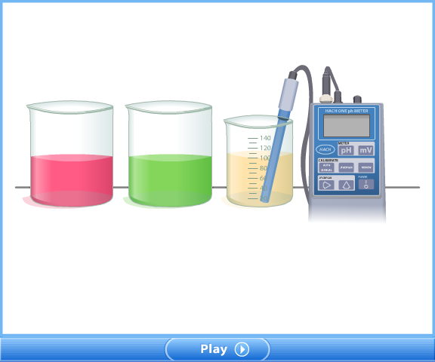
Chapter 4
2. Factors Affecting Solubility
3. The common-Ion Effect
Common ion decreases the solubility.

Slide 18
Chapter 4
2. Factors Affecting Solubility
3. The common-Ion Effect
Example 6
Ksp for CaF₂ is 4x10⁻¹² at a certain temperature. How
many moles of CaF₂ can be dissolved in one liter of 1 M
Ca(NO₃)₂ solution?
Solution
Ca(NO₃)₂(s) → Ca⁺²(aq) + 2NO₃⁻¹(aq)
1 M 1 M 2 M
And CaF₂ will establish an equilibrium,

Slide 19
Chapter 4
2. Factors Affecting Solubility
Solution
CaF₂(s) ⇔ Ca⁺²(aq) + 2F⁻¹(aq)
(1 + x) M 2x M
Ksp = [Ca⁺²] [F⁻¹]² = (1+x)(2x)² = 4x10⁻¹² , x in 1+x is so
small it can be neglected.
x = 1x10⁻⁶ M
Solubility of CaF₂ in Ca(NO₃)₂ is 1x10⁻⁶ M, it was 1x10⁻⁴ M.
Common ion Ca⁺² decreased the solubility.

Slide 20
Chapter 4
3. Selective Precipitation
It involves the precipitation of metal ion by using another solution whose anion forms an insoluble salt with the desirable ion in the mixture.
Example 7
Solid K₂SO₄ is added slowly to a solution that contains 0.01 M
Pb(NO₃)₂ and 0.01 M AgNO₃.
Which compound will precipitate first?
Within what range should the sulfate ion concentration be
held to separate Pb⁺² ions from Ag⁺ ions?
Ksp is 2x10⁻⁸ for PbSO₄ and is 2x10⁻⁵ for Ag₂SO₄.

Slide 21
Chapter 4
3. Selective Precipitation
Solution
a. PbSO₄(s) ⇔ Pb⁺²(aq) + SO₄⁻²(aq)
Ksp = 2x10⁻⁸ = [Pb⁺²] [SO₄⁻²] = (0.01) [SO₄⁻²]
[SO₄⁻²] = 2x10⁻⁶ M
Ag₂SO₄(s) ⇔ Ag⁺¹(aq) + 2SO₄⁻²(aq)
Ksp = 2x10⁻⁵ = [Ag⁺¹] [SO₄⁻²]² = (0.01)[SO₄⁻²]²
[SO₄⁻²] = 2x10⁻¹ M
PbSO₄ will precipitate first.
b. 2x10⁻⁶ <SO₄⁻² < 2x10⁻¹

Slide 22
Chapter 4
4. Quantitative Analysis of Cations
The objective of qualitative analysis is to separate and identify the cations present in an unknown solution. Cations are first separated into five main groups depending on their solubilities.
Group: Ag⁺, Pb²⁺, and Hg²⁺ ions: HCl is added to precipitate
them.
Group: Bi³⁺, Cu²⁺, Sn⁴⁺, Hg²⁺, Sb⁺³, and Cd²⁺ions: H₂S is
added to precipitate them.
Group: Ni²⁺, Ca²⁺, Fe²⁺, Mn²⁺, Zn²⁺, Al3+, and Cr³⁺ions: OH⁻
is added to precipitate them.

Slide 23
Chapter 4
4. Quantitative Analysis of Cations
Group: Ca²⁺, Ba²⁺, and Mg²⁺: CO₃⁻² is added to precipitate
them.
Group: NH4¹⁺, Na¹⁺, and K¹⁺ ions: Flame test is applied.

Slide 24
End of the chapter 4

